Slide 1




Juniorprof. Dr. Heiko Holz – Bridging Horizons: UCI-Tübingen
AI in Language Learning and Teaching
Insights Into Tools, Prospects, & Future Directions

Slide 2
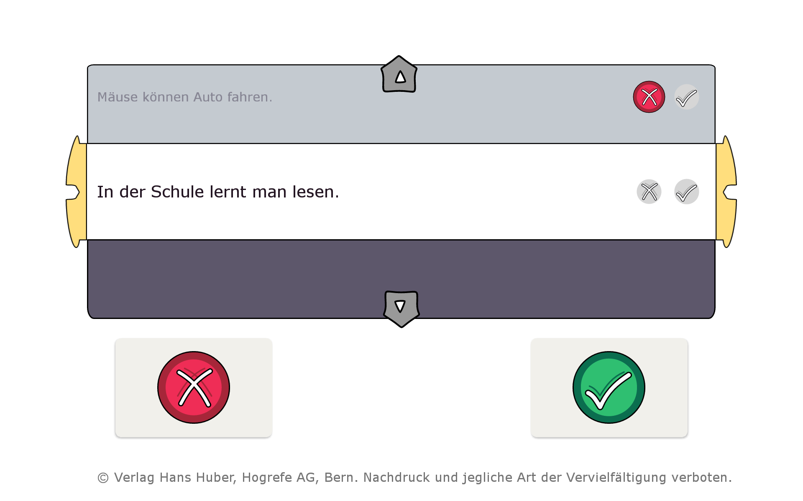
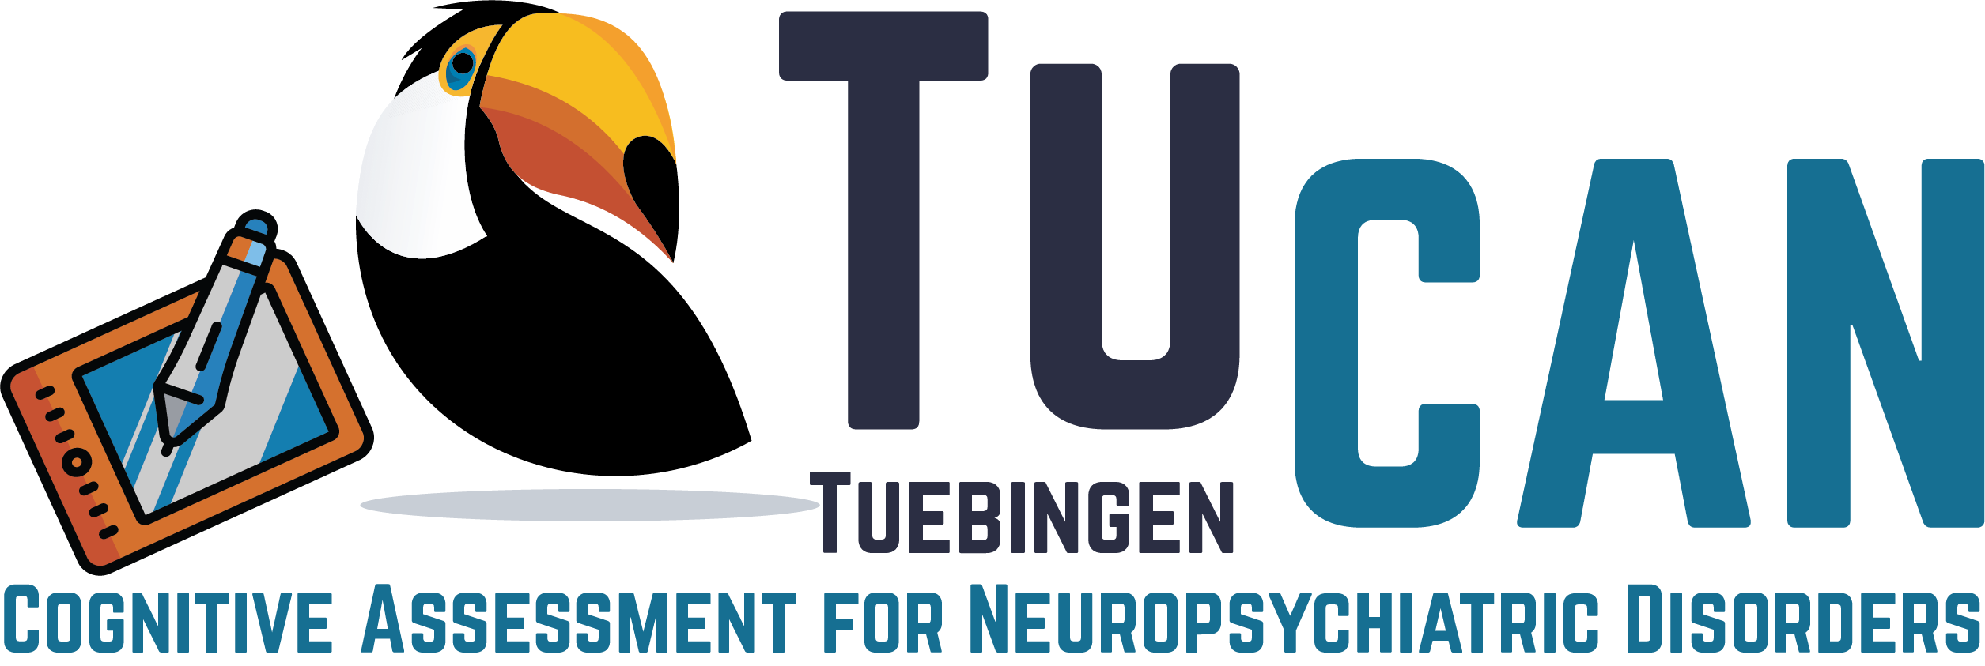
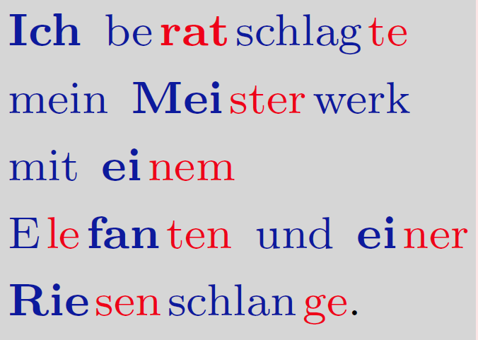
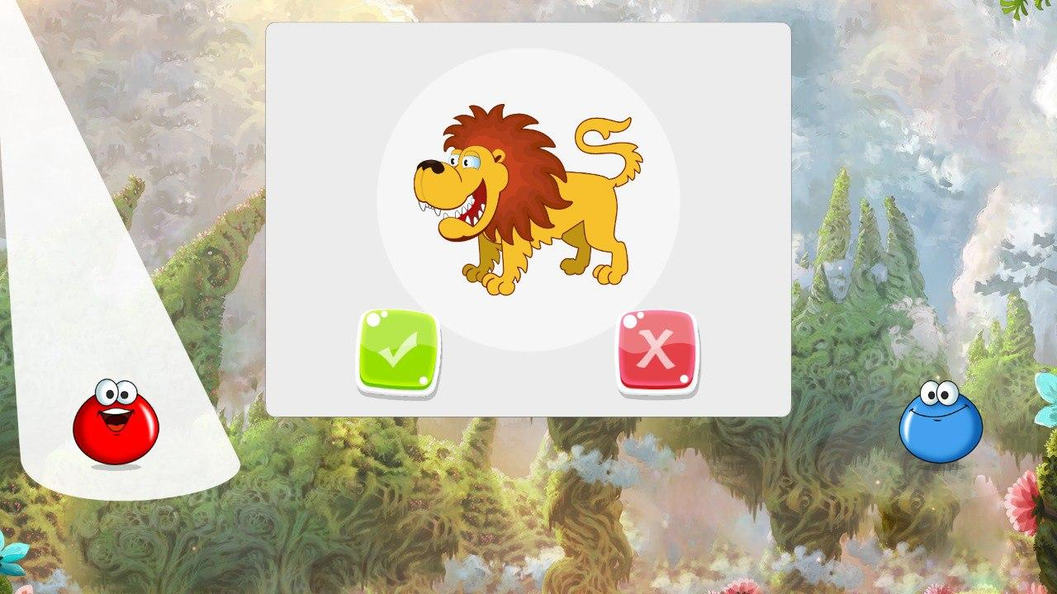

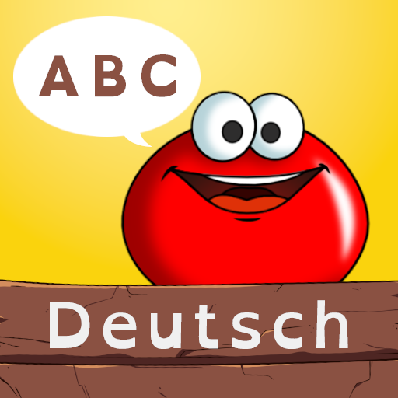


How Can AI Support Literacy Acquisition?
Digi-SLS
COAST
Prosodiya-Screening
Intervention
Screening & Diagnostics
Automatic Generation of Learning Material
Digital
(AI-based) Tools for Evidence-Based Literacy and Foreign Language Acquisition
Didactically Motivated And Reflective Use of AI Tools
Prosodiya
AI-LIT
Notes:
Ende: 4 Minuten
Prosodiya – ein Lernspiel zur Förderung der Rechtschreibleistung für Grundschulkinder
Interaktionsstile unter der Lupe: Drag-and-Drop vs. Point-and-Touch vs. Touch
Automatische Erstellung binnendifferenzierten Lernmaterials

Slide 3



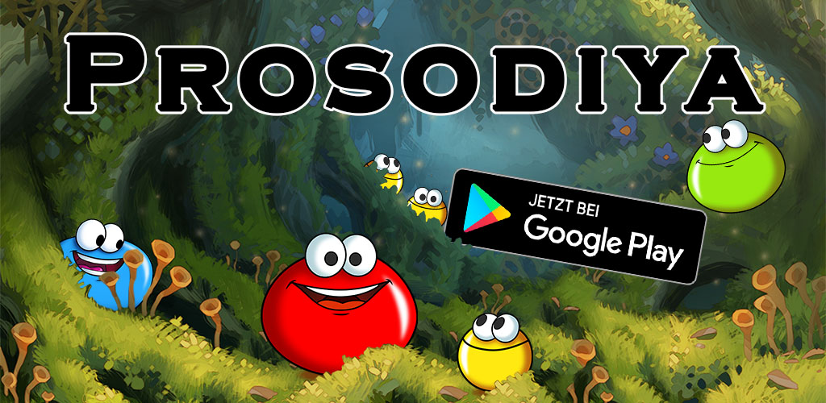
Prosodiya
A Digital Game-Based Spelling Training For German Primary School Children
Notes:
4 Minuten

Slide 4
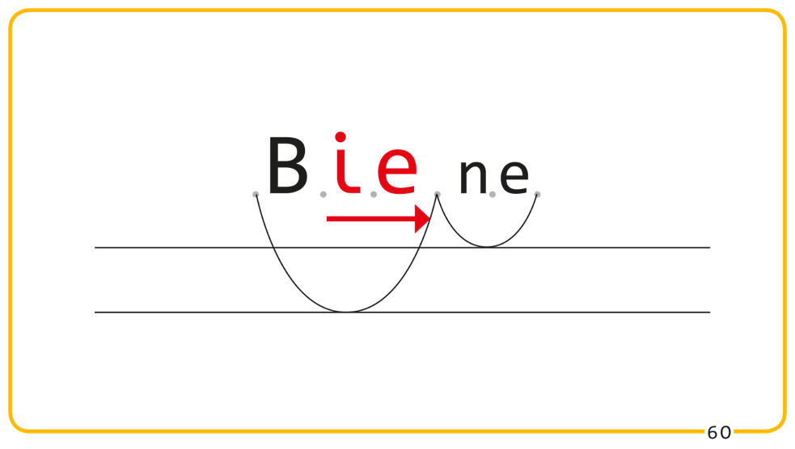
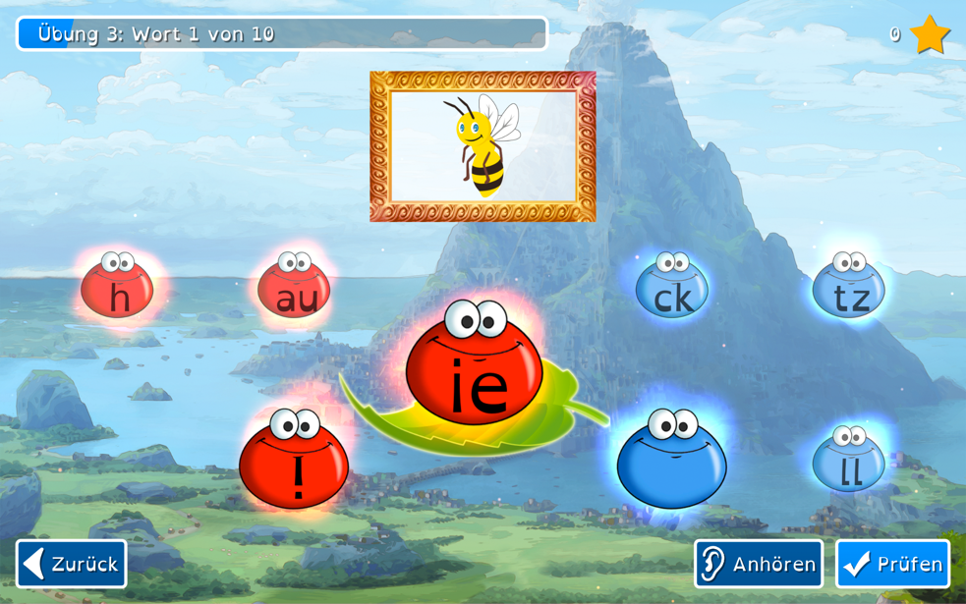
Prosodiya:
From Speech Rhythm to Spelling
Notes:
6 Minuten
Die Vokallängenmarkierung ist eine besondere Schwierigkeit für Kinder mit LRS.
Eine Erklärung hierfür ist ….

Slide 5
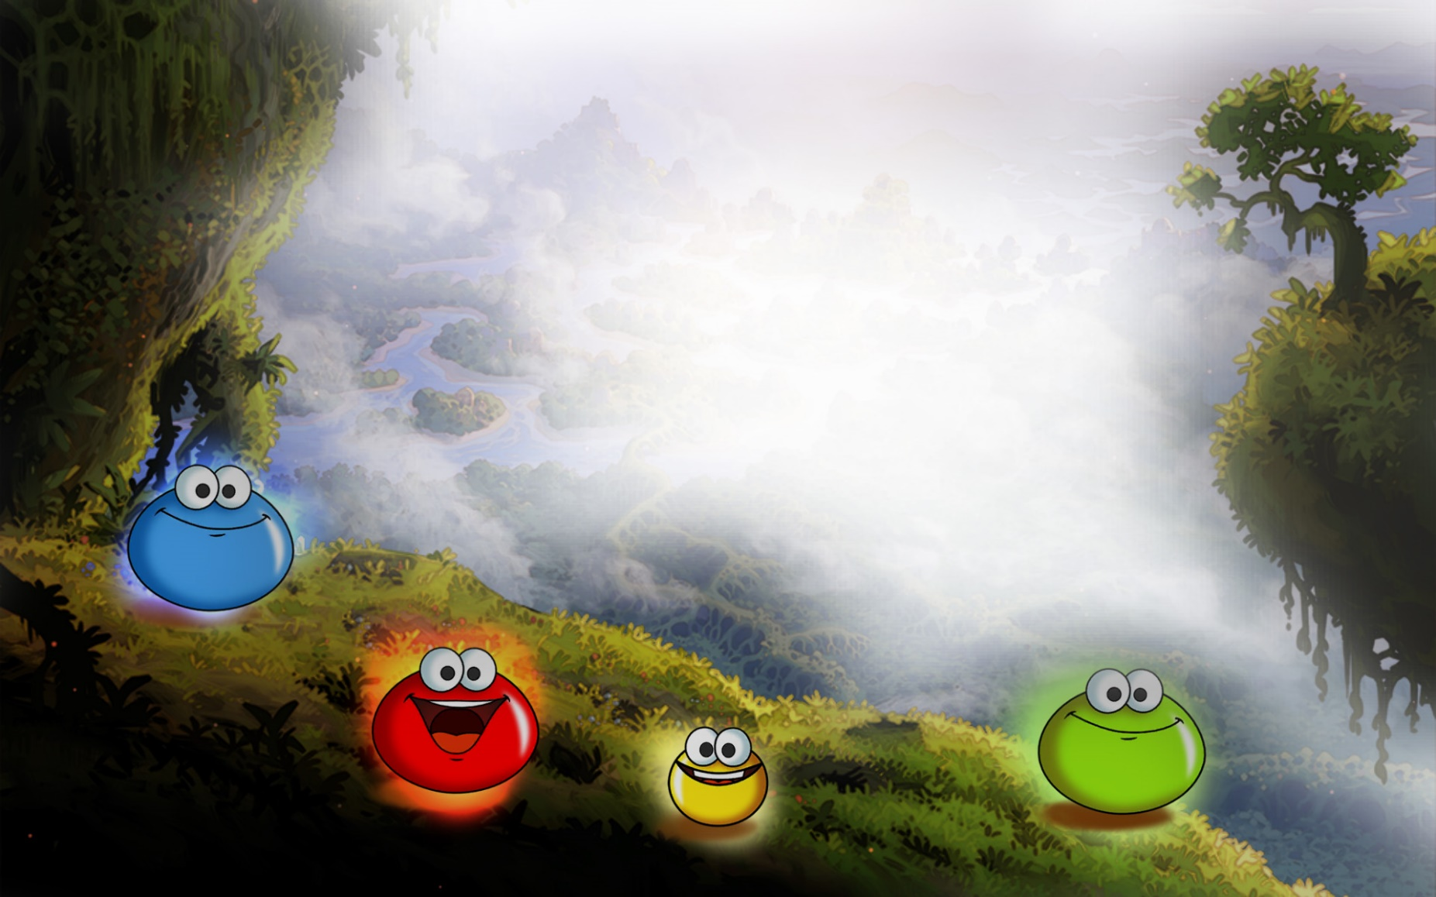


Rettet Prosodiya!

Slide 6
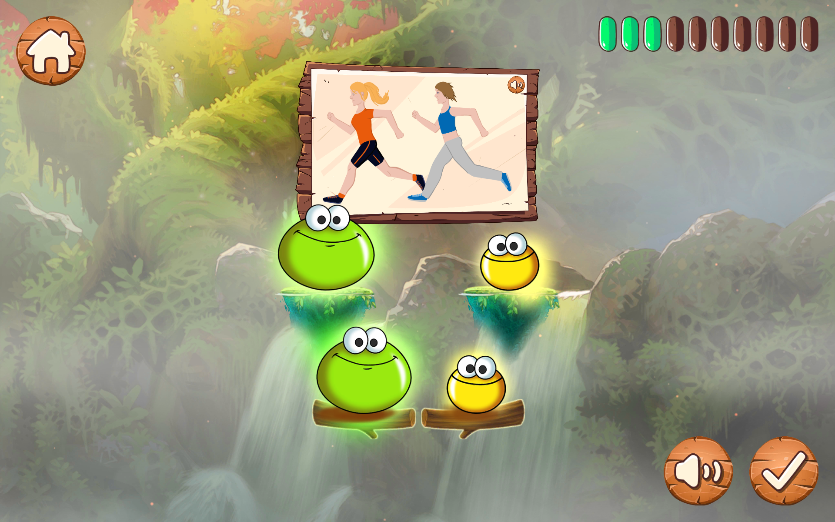
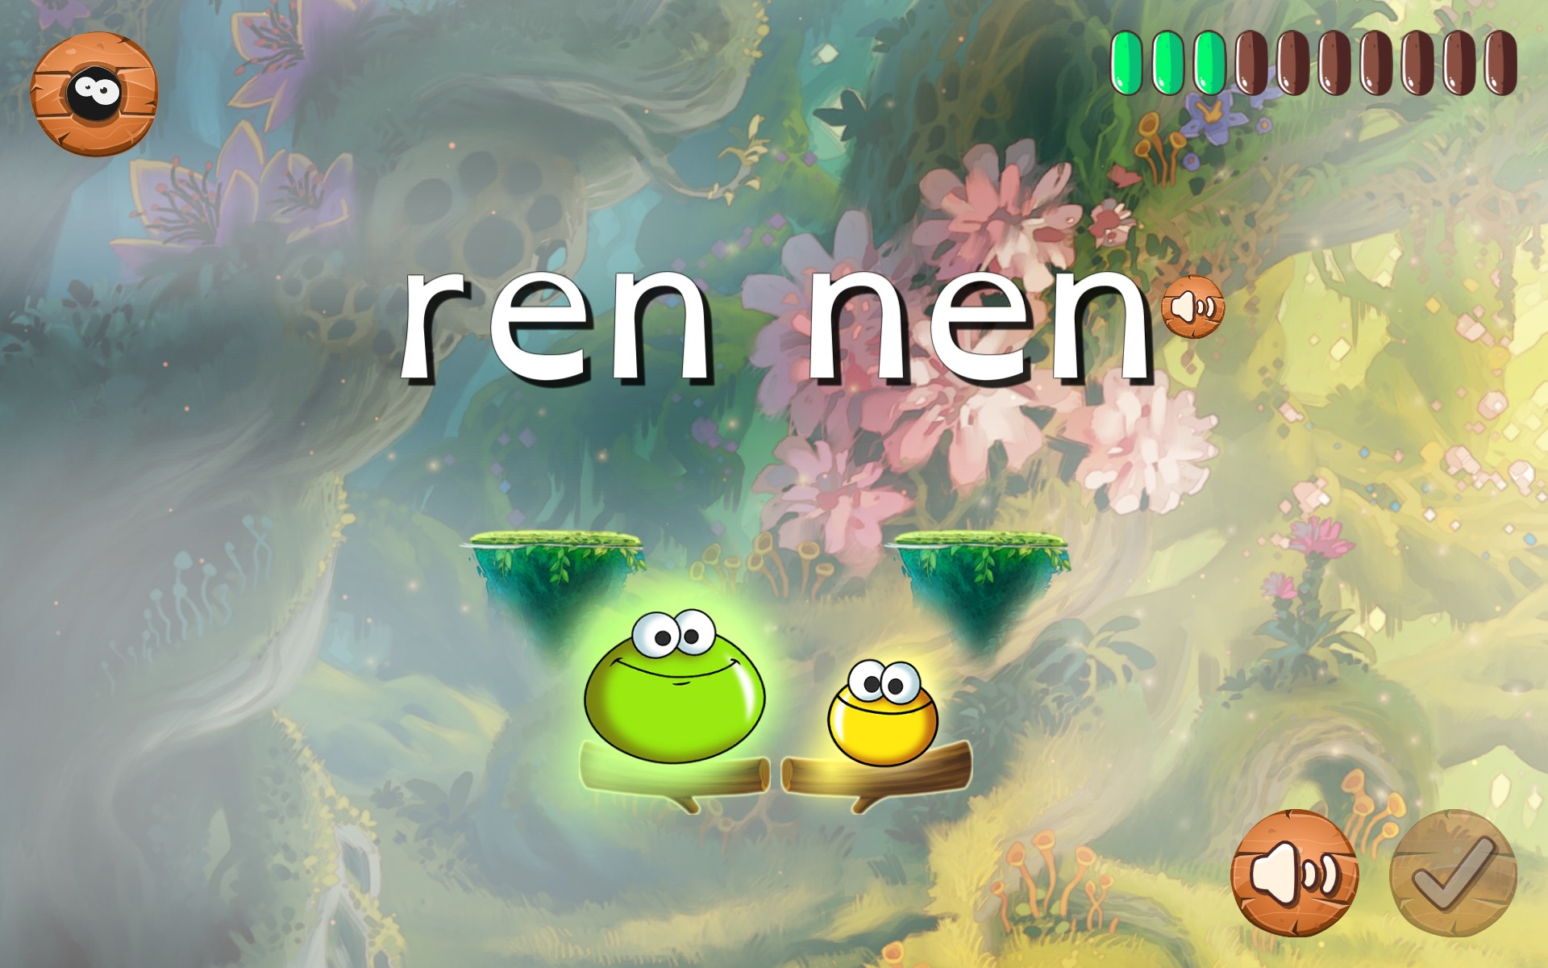
Prosodiya
Game 1: “Find the stressed syllable”
Potential use of AI: Analyze children's pronunciation (stress) automatically

Slide 7
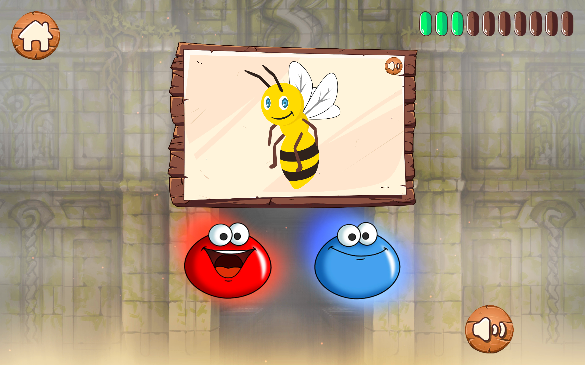
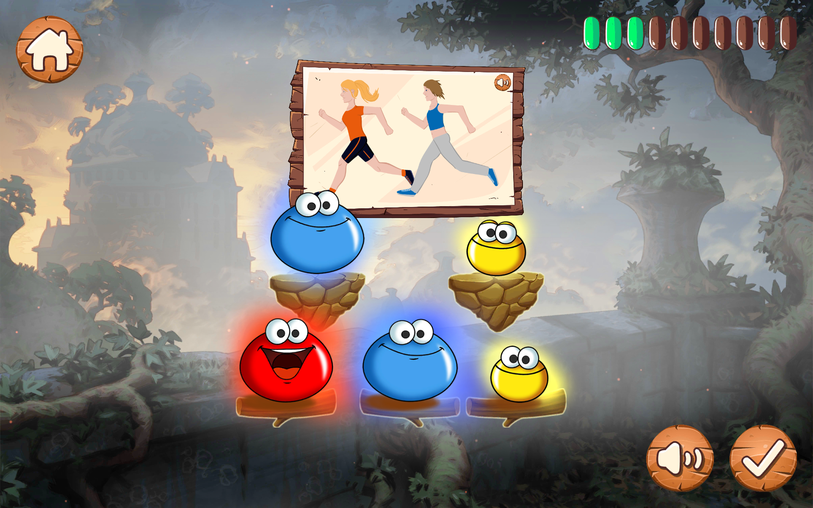
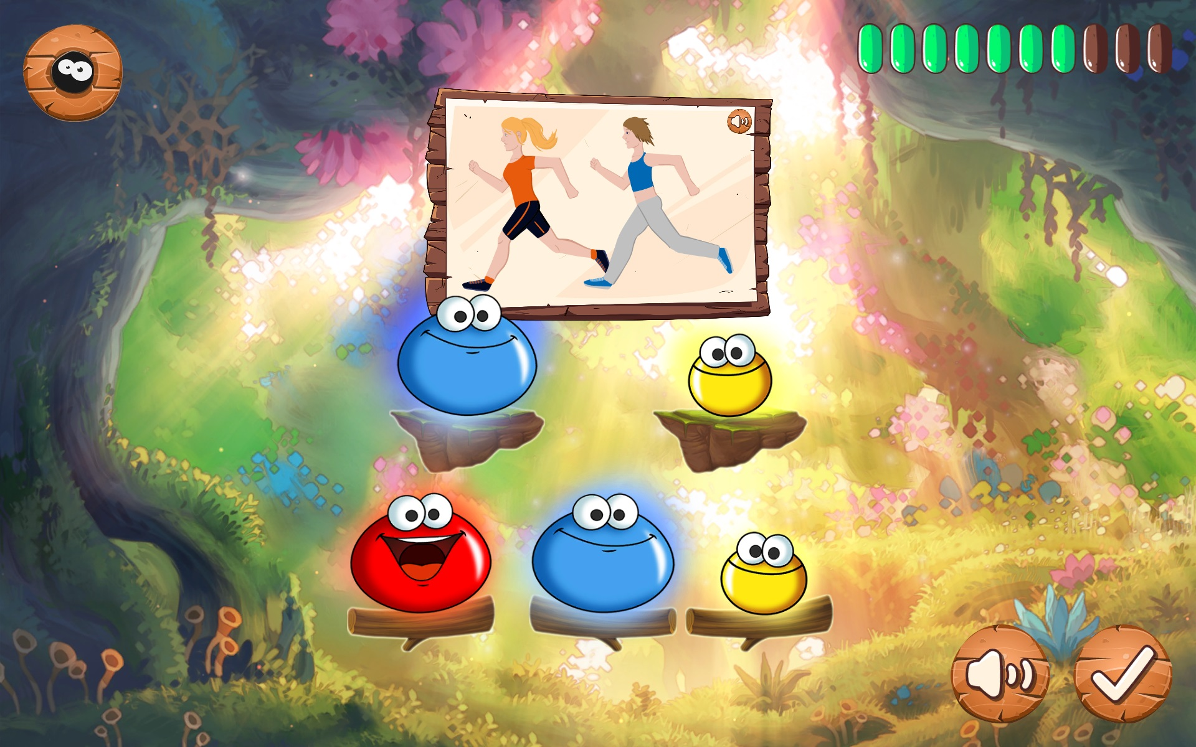

Prosodiya
Game 2: “Open and closed syllables”
Potential use of AI: automatic generation of spoken minimal pairs (Holz et al., 2018)
Notes:
Hinweis: Minimalpaare über KI (Sprachsynthese) erzeugbar!

Slide 8
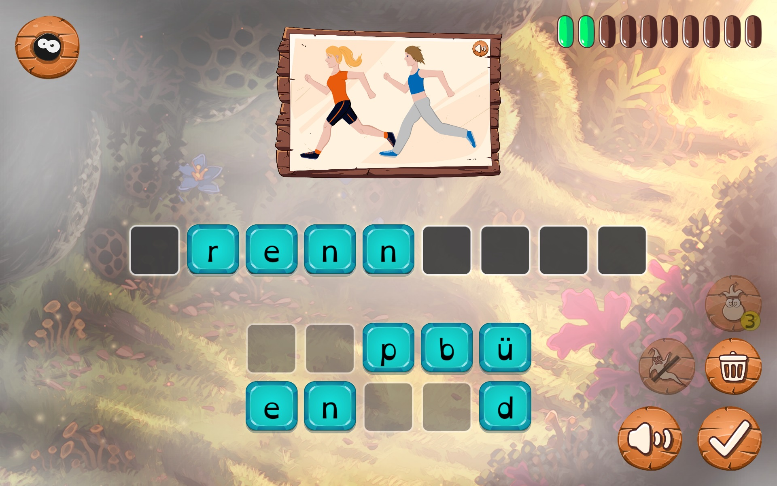
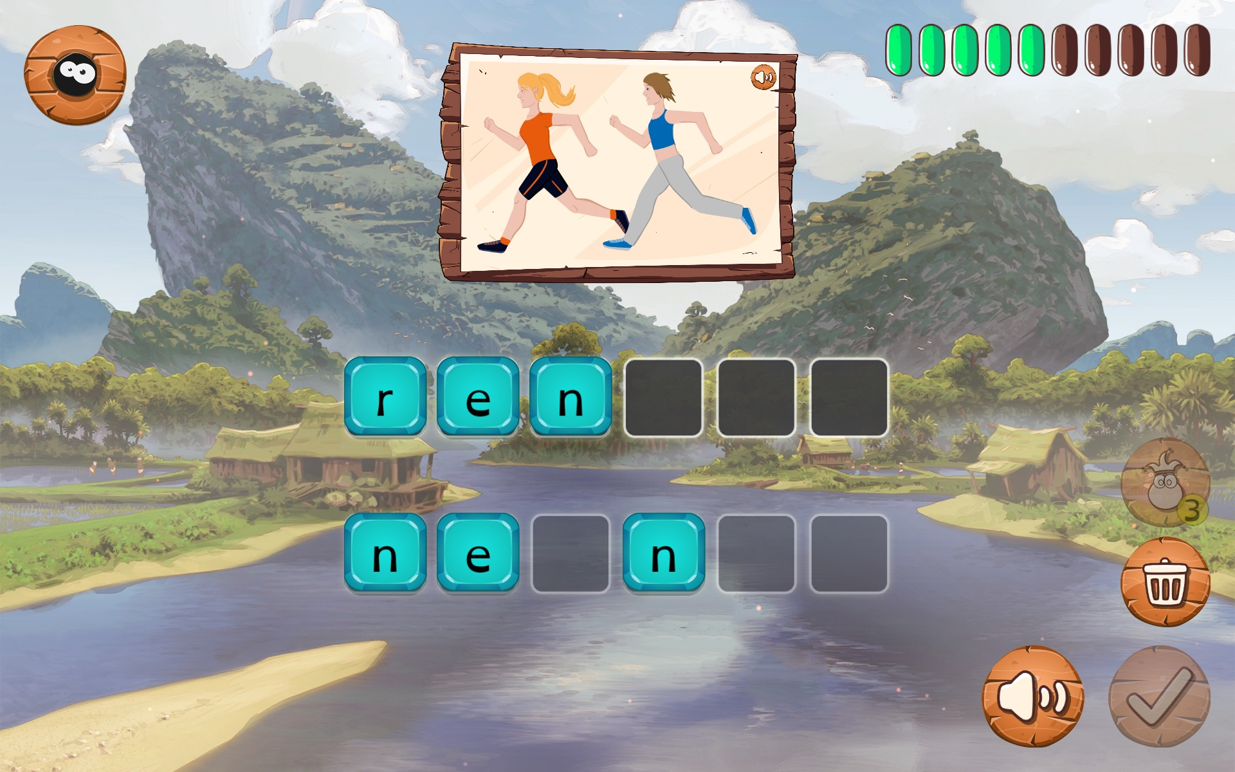
Prosodiya
Game 4: “Spelling”
Notes:
Ende: 10-11 Minuten

Slide 9
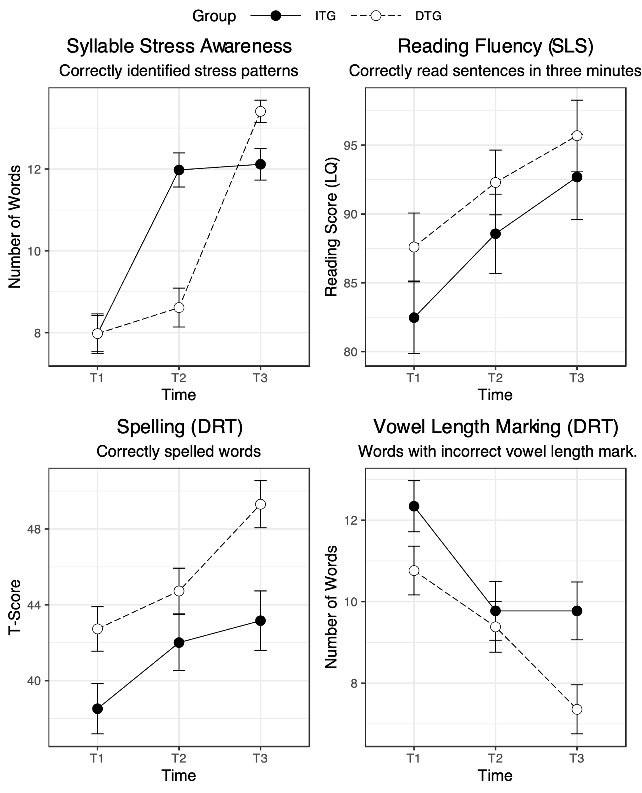
Evaluation of Prosodiya:
Randomized Controlled Field Trial
In 2018, 116 primary school children from the area of Tübingen (Germany) participated in the Prosodiya intervention study
﻿Two-period, wait-list controlled crossover treatment design
Notes:
10-11 Minuten

Slide 10
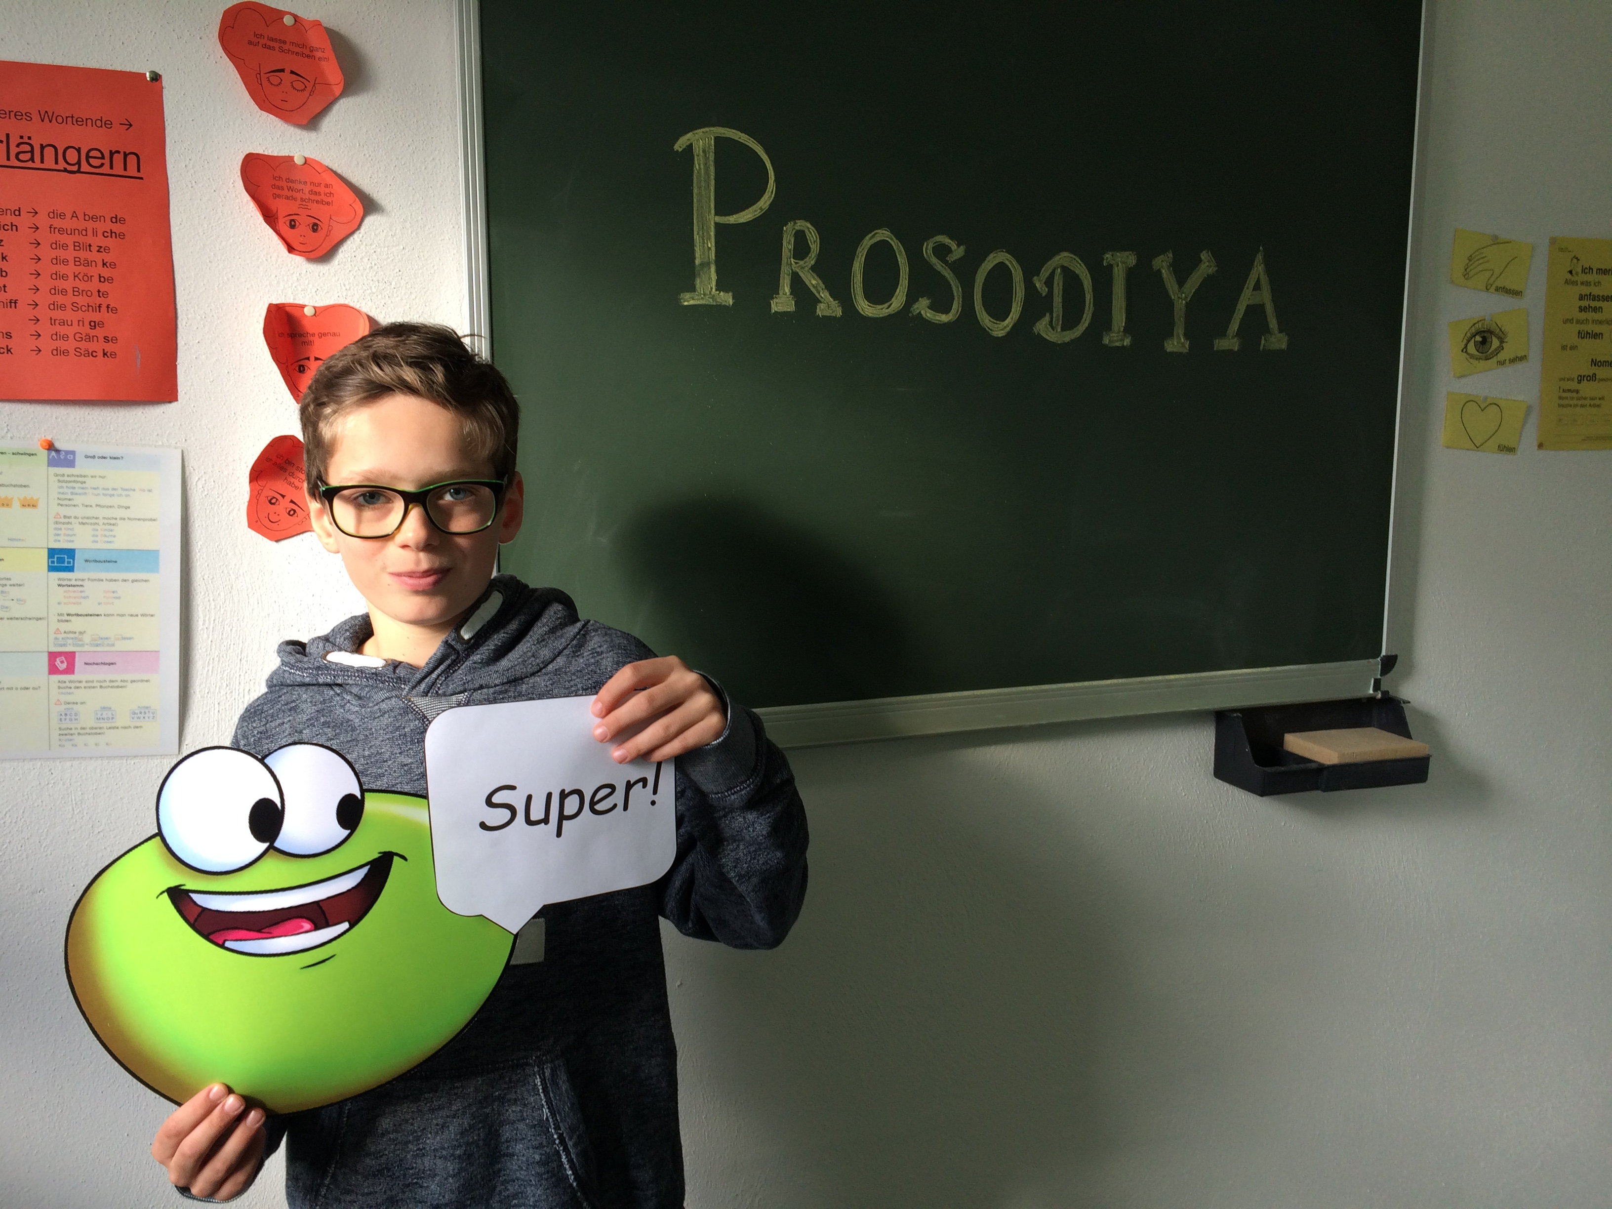
Summary of the Results
Validity:
  Correlation between stress perception and reading and spelling performance demonstrated/replicated.
  Correlation between training and spelling performance indicates effective implementation.
Effectiveness:
  Prosodiya improves syllable stress awareness and spelling of primary school children
Feasibility:
  Prosodiya is feasible for use at home
  Prosodiya motivates children over longer period of time and is well received by parents and teachers
Notes:
Ende: 16 Minuten

Slide 11
Summary of the Results
Validity:
  Correlation between stress perception and reading and spelling performance demonstrated/replicated.
  Correlation between training and spelling performance indicates effective implementation.
Effectiveness:
  Prosodiya improves syllable stress awareness and spelling of primary school children
Feasibility:
  Prosodiya is feasible for use at home
  Prosodiya motivates children over longer periods and is well received by parents and teachers
Notes:
Ende: 16 Minuten

Slide 12
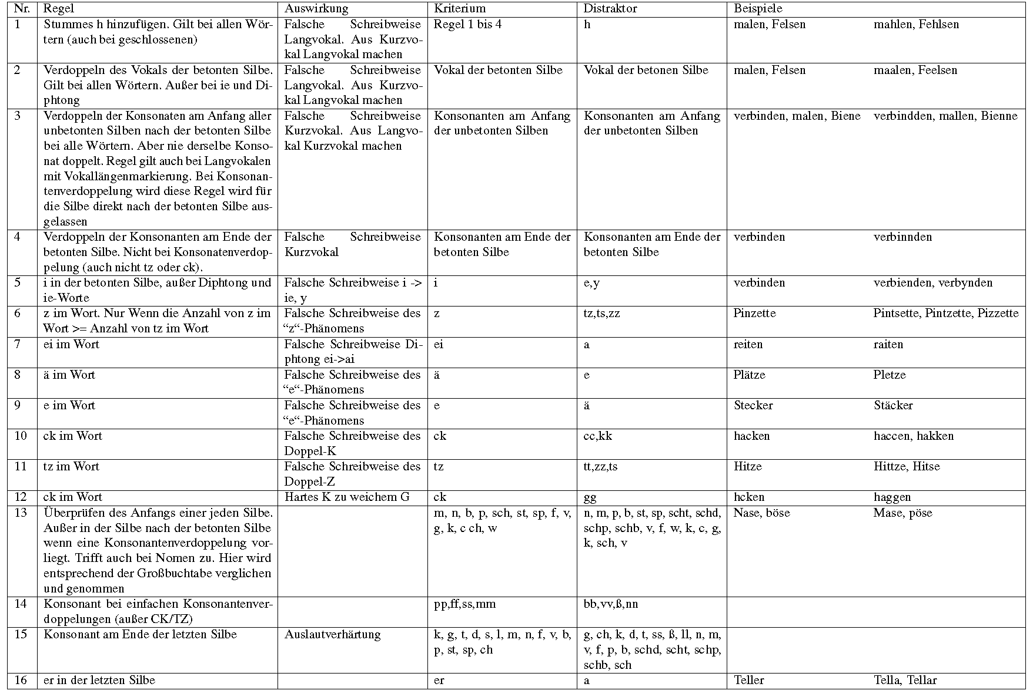
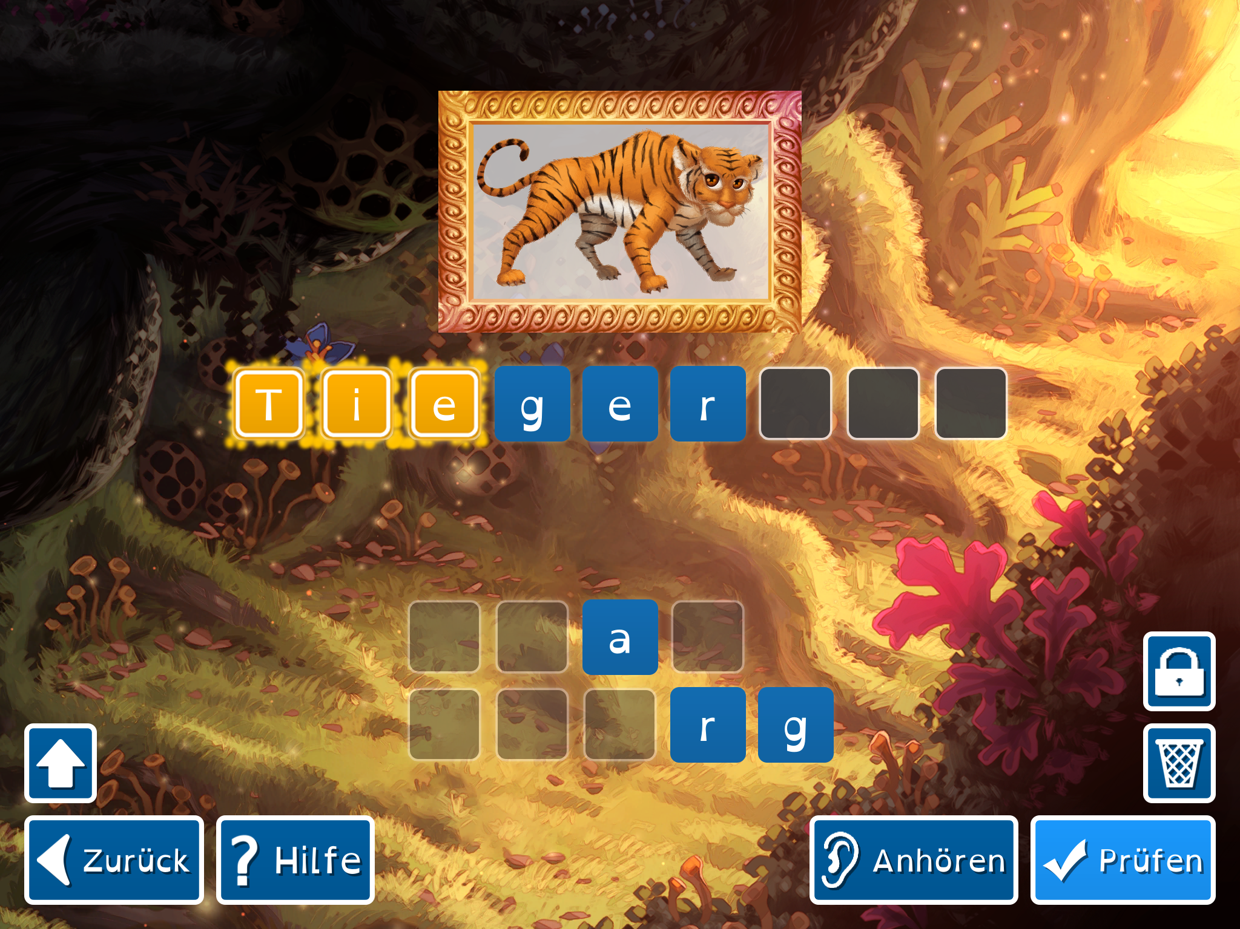
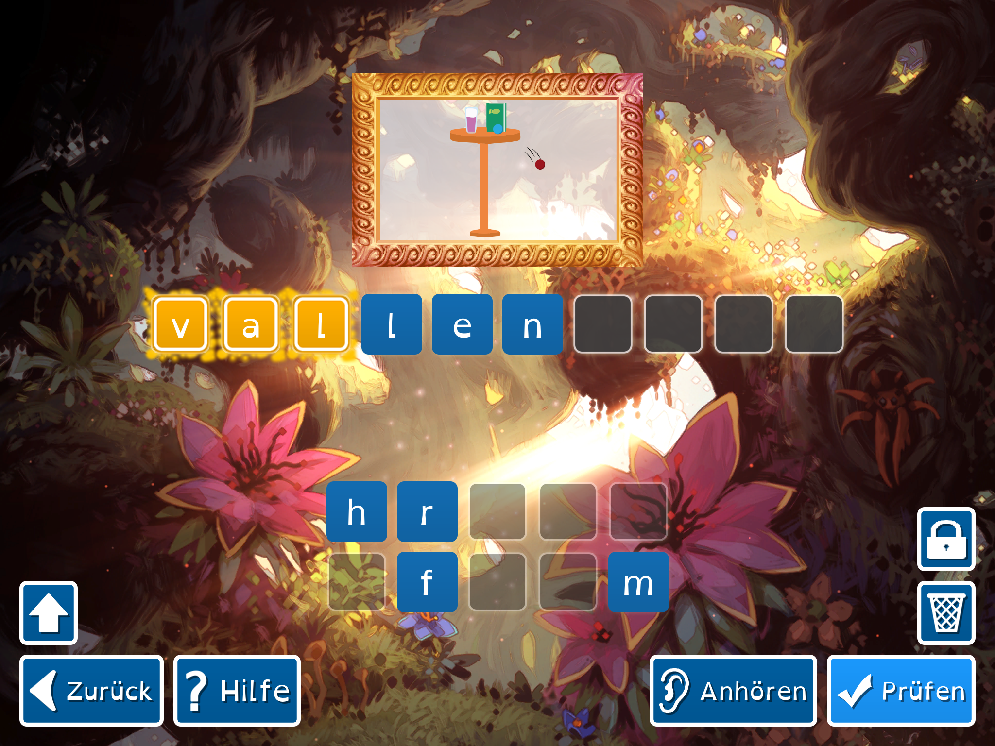
Outlook: Scaffolded Feedback
Error rules derived from literature, practice and empirical evidence
Nr | Regel und Bedingung | Auswirkung | Kriterium | Distraktor | Beispiele
1 | Stummes h hinzufügen. Gilt bei allen Wörtern (auch bei geschlossenen) | Falsche Schreibweise Langvokal. Aus Kurzvokal Langvokal machen | Regel 1-4 | H | malen, Felsen, | mahlen, Fehlsen
2 | Verdoppeln des Vokals der betonten Silbe. Gilt bei allen Wörtern. Außer bei ie und Diphthong | Falsche Schreibweise Langvokal. Aus Kurzvokal Langvokal machen | Vokal der betonten Silbe | Vokal der betonen Silbe | malen, Felsen, | maalen, Feelsen
3 | Verdoppeln der Konsonanten am Anfang aller unbetonten Silben nach der betonten Silbe bei allen Wörtern. Aber nie derselbe Konsonant doppelt. Regel gilt auch bei Langvokalen mit Vokallängenmarkierung. Bei Konsonantenverdoppelung wird diese Regel wird für die Silbe direkt nach der betonten Silbe aus- gelassen | Falsche Schreibweise Kurzvokal. Aus Langvokal Kurzvokal machen | Konsonanten am Anfang der unbetonten Silben | Konsonanten am Anfang der unbetonten Silben | verbinden, malen | verbindden, mallen
 | … | … | … | … | …

Slide 13
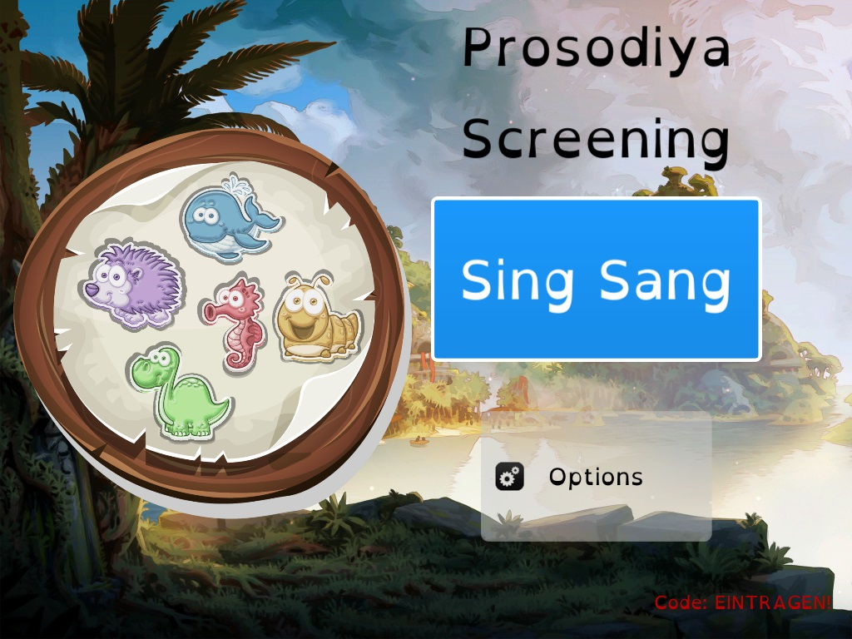
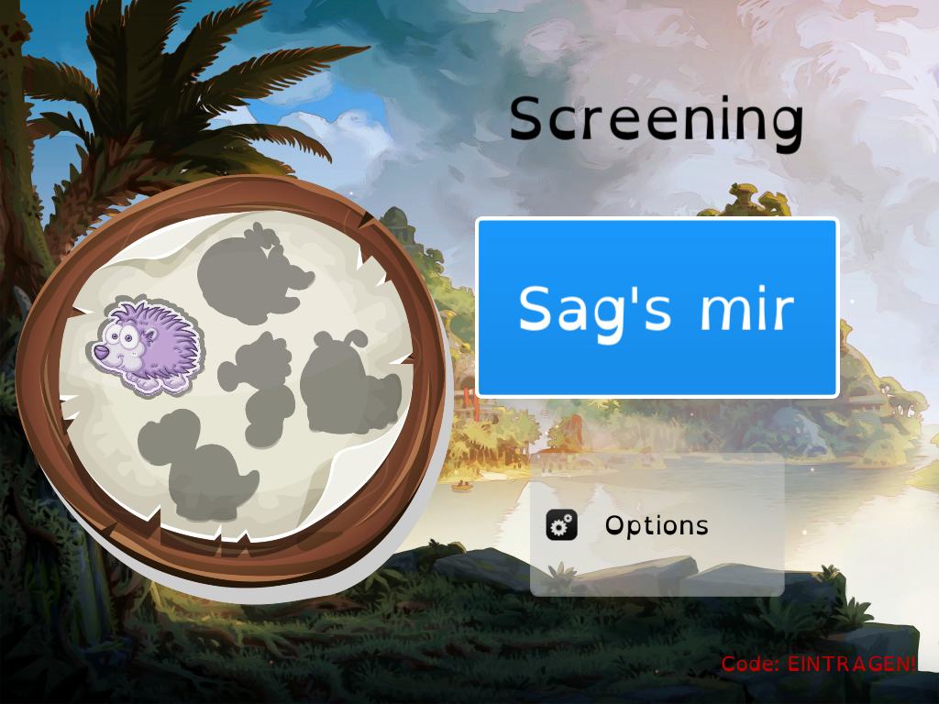
Prosodiya Pre-Screening
﻿A Digital, Game- and Group-Based Screening for Pre-Readers at Risk for Dyslexia
Notes:
The ability to conduct screenings digitally and in group sessions would allow teachers to effectively screen larger groups of children while reducing their workload. Digitization facilitates screening procedures by automating and standardizing them, increasing objectivity and reliability. In addition, game-based elements can be integrated into the screening, which is more fun for the children and increases their motivation [e.g., 7].
Group-based settings are commonly used because testing each child individually is both time-consuming and costly, and these tests are traditionally performed on paper [19]
The design and implementation of a digital, game- and group-based literacy screening poses several challenges regarding child-computer interaction. For young children, it is especially challenging to implement appropriate user interfaces and interaction mechanics as it not only depends on their physical and mental development [e.g., 36, 102], but also on their previous experience with the use of technology [3]

Slide 14
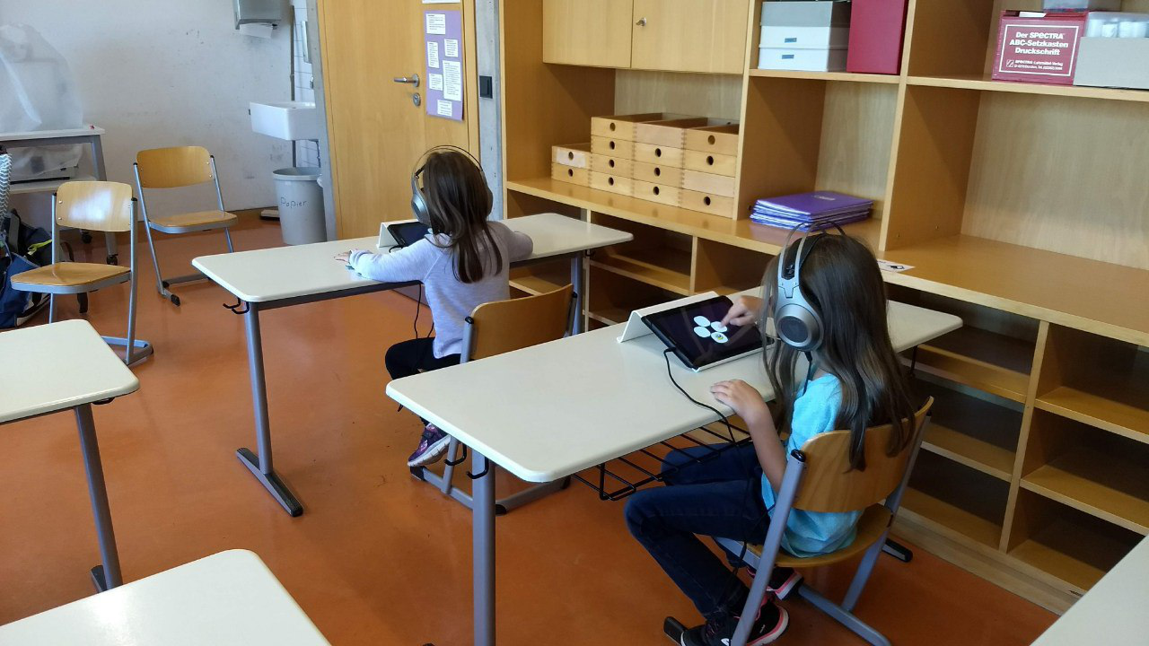
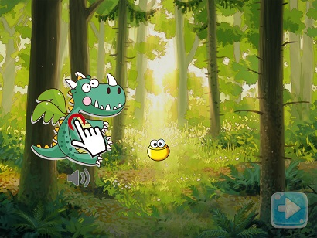
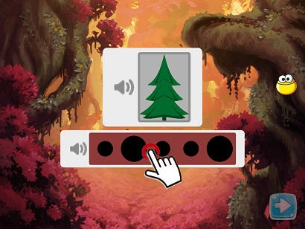
Tutorials + Tasks
Group testing
Tutorials for each task
  Kugellichter as companions
Requirements
  self-explanatory
  interactive
  motivating
  easy to use
  valid and reliable
Notes:
Enger Zusammenarbeit mit Linguistin

Slide 15
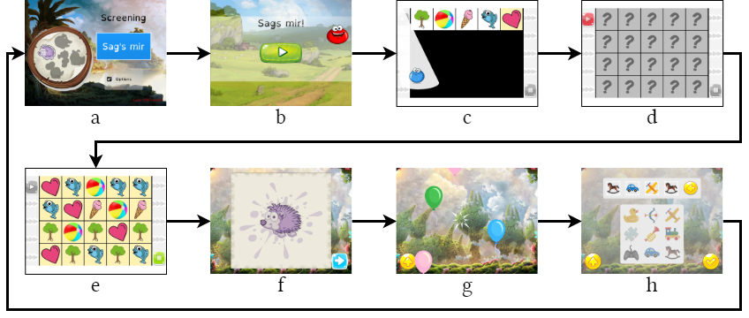
Exemplary Procedure of a Task

Slide 16
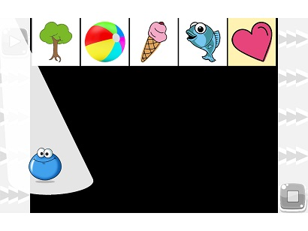
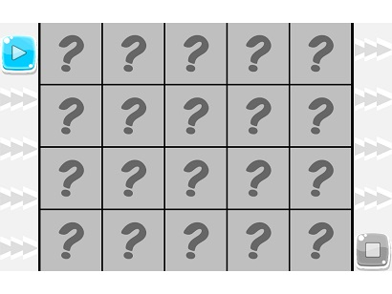
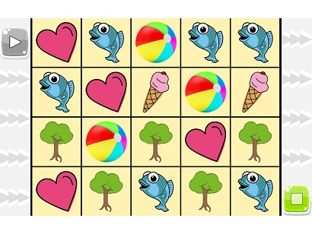
Screening Task „Tell Me“
Background: Rapid Automatized Naming (RAN)
(Catts, Fey, Zhang, & Tomblin, 2001)
  Loud naming of monosyllabic symbols (naming speed)
  Group differences between dyslexic and non-dyslexic in time per item
Interactive tutorial
Before the task starts
Task, page 1/2
Notes:
Fragen:
Wie lösen wir das Problem, dass Kinder individuellen Output geben und wir Gruppentestungen durchführen müssen?
Ohrstöpsel: Keine Lösung
Headsets und Kopfhörer: Abstand getestet -> Wie weit muss man auseinandersitzen, um einander nicht zu hören? -> 10 Kinder pro Raum möglich, 1 Kind pro Tisch
Schwierigkeit Tutorial: Kinder sind gehemmt laut zu sprechen
Jetzt bist du dran mit vorlesen! Wenn du bereit bist, drücke auf den (farbe) Startknopf.
Sobald die Karten aufgedeckt sind, lies sie mir so schnell du kannst vor.

Slide 17
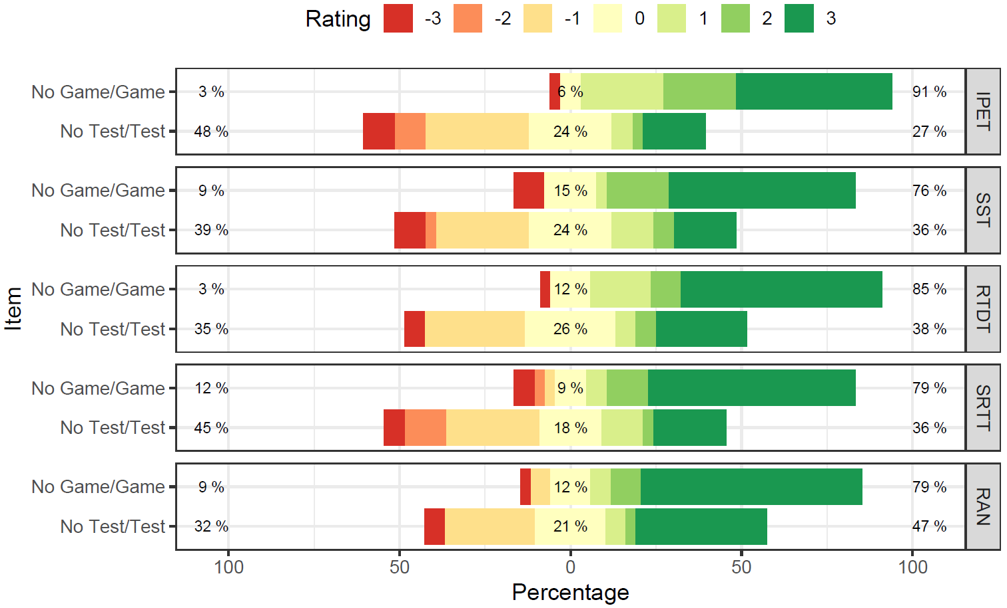
Screening as “Playful Assessment”
Results of a Feasibility Study(Holz et al., 2024; N = 34)
Group testing works: children use the app independently without distracting others
Positive gaming and user experience: tasks are fun and playful (considered more as a game than exercise/test), improving concentration and motivation
Results of of the Game Experience Questionnaire (GEQ)
Results of the User Experience Questionnaire (UEQ)
Notes:
- Evaluierung der user und game experience
- fragebögen innerhalb der app nach jeder übung
- testungsangst verringern!
UEQ links – Skala -3 bis 3
GEQ rechts, Skala 1 bis 5

Slide 18
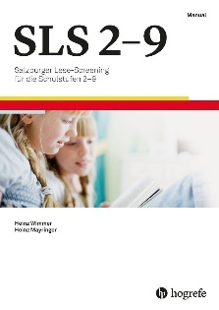

Prediction Models
Regression and Classification
Predictors of reading, extracted from the tasks
Prädiktor
Reading skill
Prädiktor
final model
optimize
Prädiktor
Prädiktor
prediction
Prädiktor
Predictors of spelling, extracted from the tasks
Prädiktor
Spelling skill
final model
optimize
Prädiktor
Prädiktor
predictions
Prädiktor
Prädiktor
Notes:
Prädiktoren finden anhand der Aufgaben

Slide 19
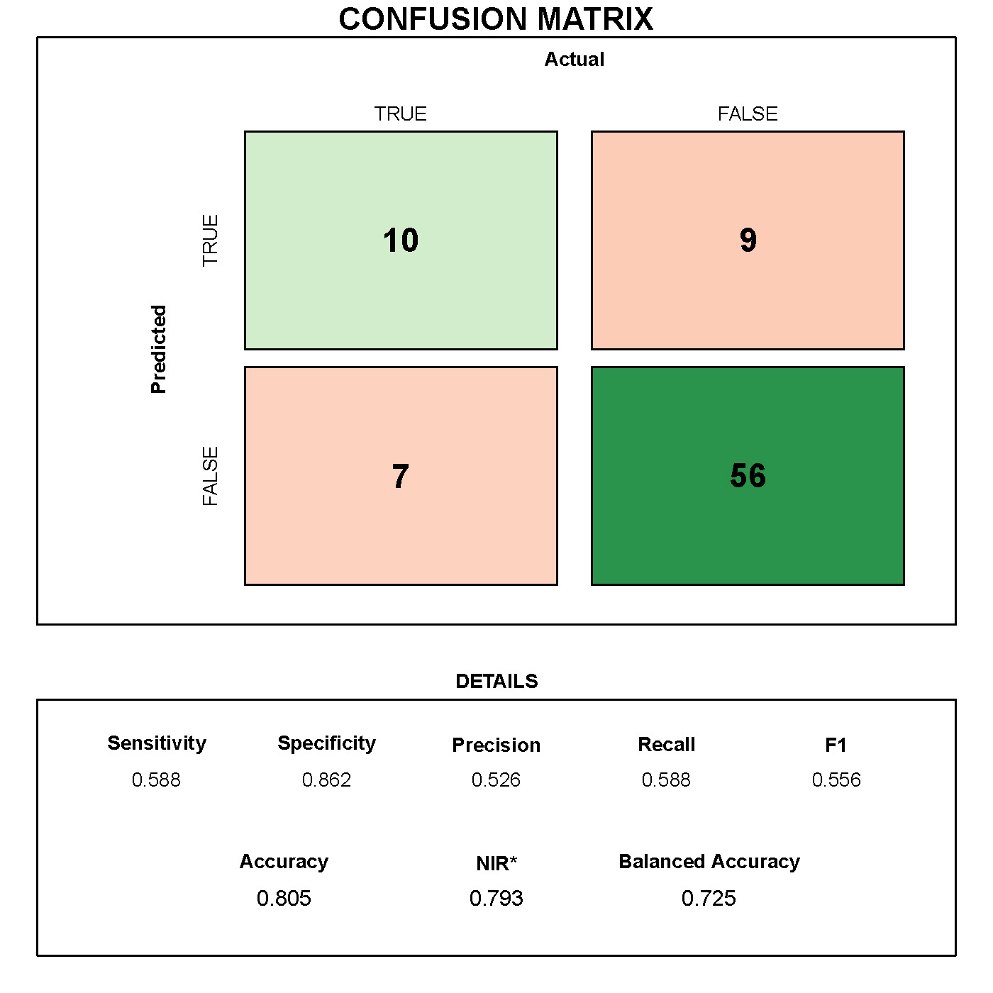
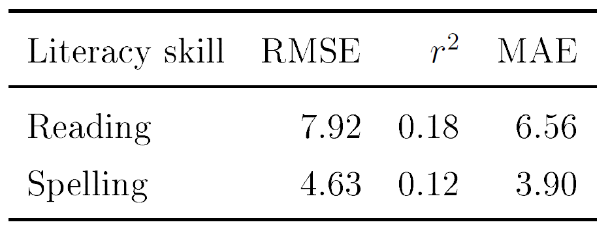
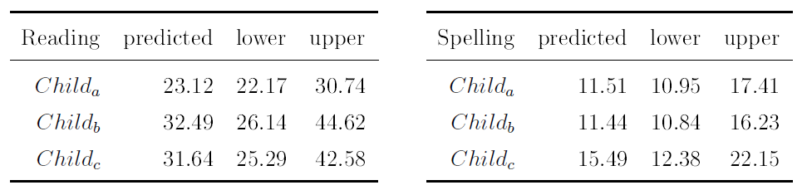
Evaluation of the Final Random Forest Model n = 310
Overall performance
Prediction exemplarily in three children
Notes:
Rregression and Classification Performance

Slide 20
Comparison of German Screenings for Dyslexia in Pre-Literate Children
Screening | Year | RATZ | PPV | Sens. | Spec. | Test Type | Duration (min) | Medium
DP (Differenzierungsprobe) | 1975 | 25% | 20% | 33% |  | Individual | 7 | Paper
BISC (Bielefelder Screening) | 1999/2020 | 14-44% | 50% | 50% |  | Individual | 25 | Paper
RdH (Rundgang durch Hörhausen) | 2002/2014 | 25% reading 77% spelling | 63% | 38-48% | 80% | Individual | 45 | Paper
PB-LRS | 2004/2019 | 55% | 36% | 63% | 87% | Group | 60 | Paper
MÜSC (Münsteraner Screenings) | 2005 | 60% (not replicated) | 66% | 50% | 86% | Gruppe (8 kids) | 50 | Paper
HASE (Heidelberger Auditives Screening in der Einschuluntersuchung) | 2007/2008 | 49-59% | 4-28% | 69-76% | 60-66% | Individual | 10 | Paper and Digital
WÜSC (Würzburger LRS-Screening Laute, Reime, Sprache) | 2020 | 73% | 54% | 80% | 83% | Individual | 25 | Paper
SCHWUPP | 2022 |  | 39% | 80% | 83% | Individual | 38 | Paper and Digital (Tablet)
LOGiK-S (Logopädie im Kindergarten – Screening) | 2022 |  | 40% | 84% | 85% | Individual | 10 | Paper
Prosodiya-Screening | 2024 | 46% | 53% | 59% | 86% | Group | 45 | Digital (Tablet)

Slide 21

Bild erzeugt mit DALL·E 3
Notes:
Optimierung
Automatische Auswertung der Sprachdateien (RAN)
vor 5 Jahren noch unzureichende Genauigkeit der automatischen Spracherkennung
Performance-Optimierung auf Sensitivität und RATZ-Index
um möglichst viele Kinder mit Risiko auf LRS zu identifizieren
Weiterentwicklung: BMBF-Antrag
(Ausschreibung „Voraussetzungen für das Lesenlernen − analog und digital“)
Aufgaben erweitern/austauschen
Einbinden in ein Training → kontinuierliches/mehrfaches Assessment steigert Validität (Marx & Weber, 2006)
Evaluation: 2. Evaluationsstudie

Slide 22

COAST
Automatic Visual Enhancement of Reading Material
Notes:
Start: 25 Minuten
As explained in Section 2.2, syllable synthesis and syllable analysis are essential components of evidence-based reading and spelling trainings (Galuschka & Schulte-Körne, 2016). Scheerer-Neumann (1981) has shown that specific training of segmenting words into syllables can improve reading accuracy of reading impaired German primary school children significantly.
Additionally, computer-based programs for primary school children that sequentially speak and highlight syllables can facilitate the learning process of reading (Jiménez et al., 2007; Olson & Wise, 1992).
Based on these empirical findings, visually enhanced texts with custom spacing and syllables alternately displayed in different font colors are commonly used in teaching and learning therapy to support the acquisition of reading and writing.
This socalled “Silbenmethode” (Syllable Method; Mildenberger Verlag, 2018; Röber, 2009) teaches children to focus and understand syllables and their structures rather than single characters and is commonly used in Germany, which is reflected by popular reading materials, such as ABC der Tiere (Animal Alphabet; e.g., Handt, Kuhn, & Mrowka-Nienstedt, 2019, see Figure 6.2) and Leselöwen (Reading Lions; Loewe Verlag, 2020).
COAST ist eine WebApp für die einfache und automatische visuelle Anreicherung / Aufbereitung von Silbenstruktur, Wortbetonung und Abständen in Lesetexten unter Verwendung von NLP

Slide 23
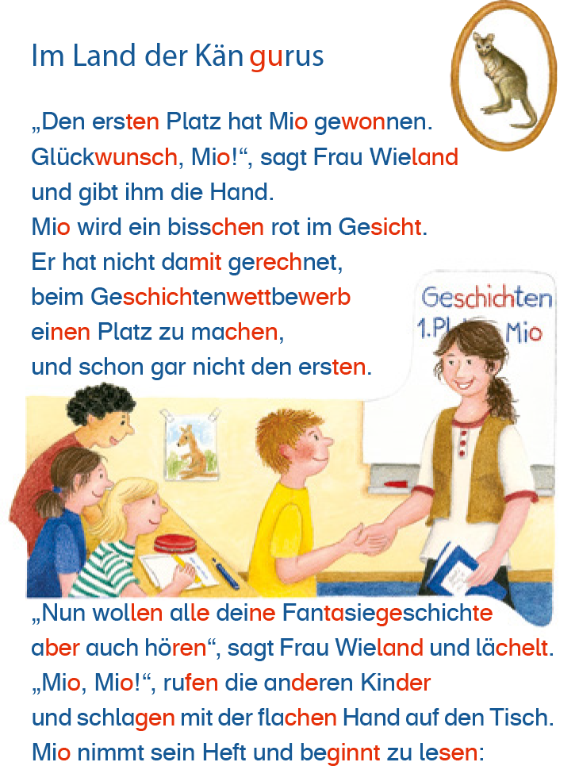
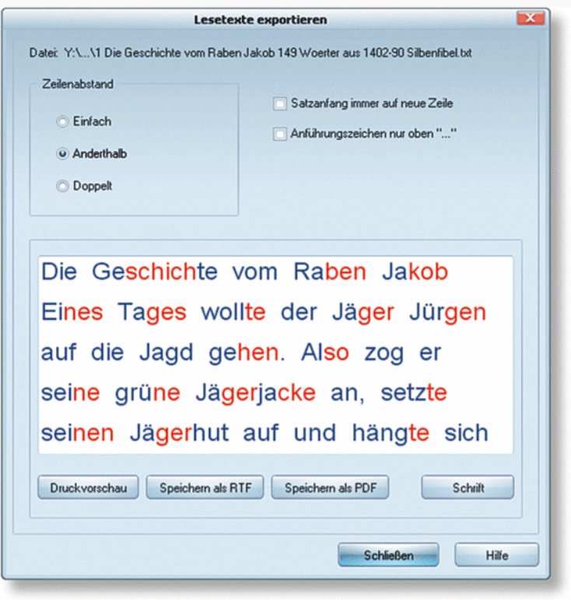
The ”Syllable Method” (Silbenmethode)
Auszug aus „Eine Einführung in die Silbenmethode“ (Mildenberger Verlag, 2018)
ABC der Tiere – Silben-Generator (Müller, 2013)
Notes:
Visually enhancing syllables in words, e.g., by alternating the font color of syllables, helps children in the process of literacy acquisition.
Published material with such syllable enhancement is available in analog and digital formats. However, the published material is limited and does not cover all the needs of young learners.
Tools that support automatic syllable enhancement in texts are only available for Windows and leave room for improvement in terms of customization.
As explained in Section 2.2, syllable synthesis and syllable analysis are essential components of evidence-based reading and spelling trainings (Galuschka & Schulte-Körne, 2016). Scheerer-Neumann (1981) has shown that specific training of segmenting words into syllables can improve reading accuracy of reading impaired German primary school children significantly.
Additionally, computer-based programs for primary school children that sequentially speak and highlight syllables can facilitate the learning process of reading (Jiménez et al., 2007; Olson & Wise, 1992).
Based on these empirical findings, visually enhanced texts with custom spacing and syllables alternately displayed in different font colors are commonly used in teaching and learning therapy to support the acquisition of reading and writing.
This socalled “Silbenmethode” (Syllable Method; Mildenberger Verlag, 2018; Röber, 2009) teaches children to focus and understand syllables and their structures rather than single characters and is commonly used in Germany, which is reflected by popular reading materials, such as ABC der Tiere (Animal Alphabet; e.g., Handt, Kuhn, & Mrowka-Nienstedt, 2019, see Figure 6.2) and Leselöwen (Reading Lions; Loewe Verlag, 2020).

Slide 24
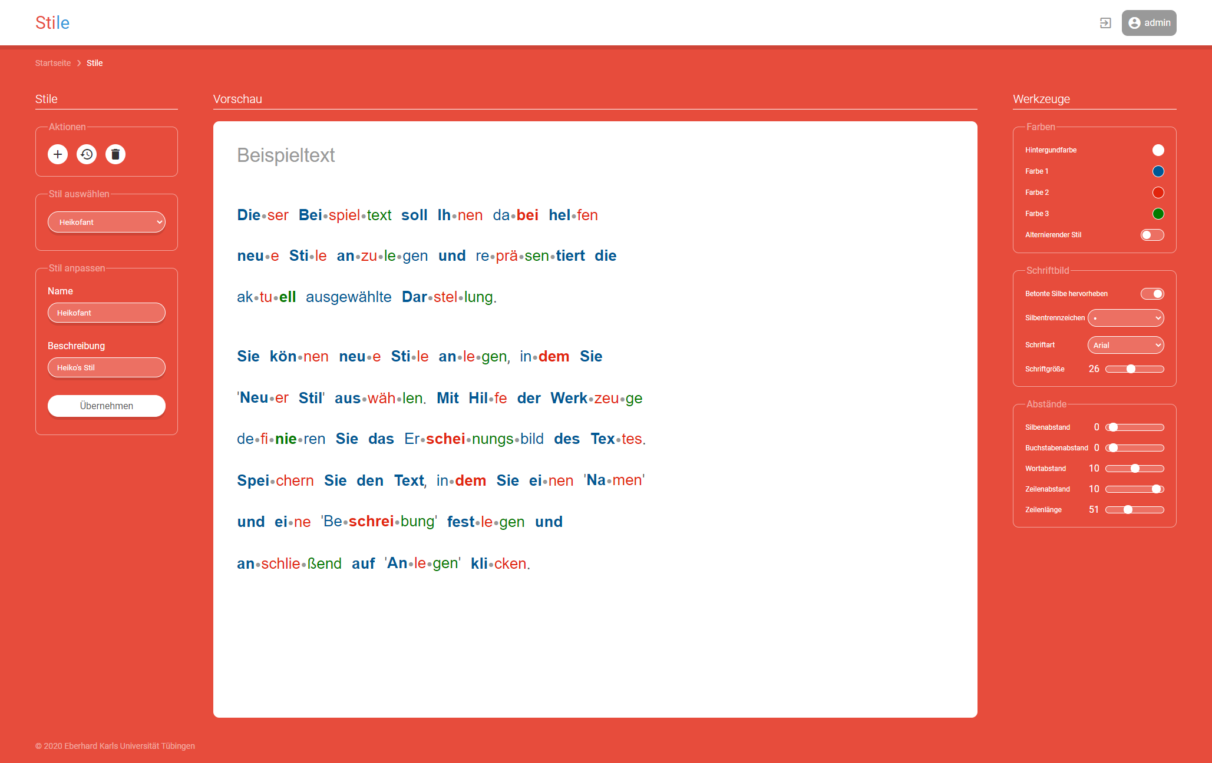
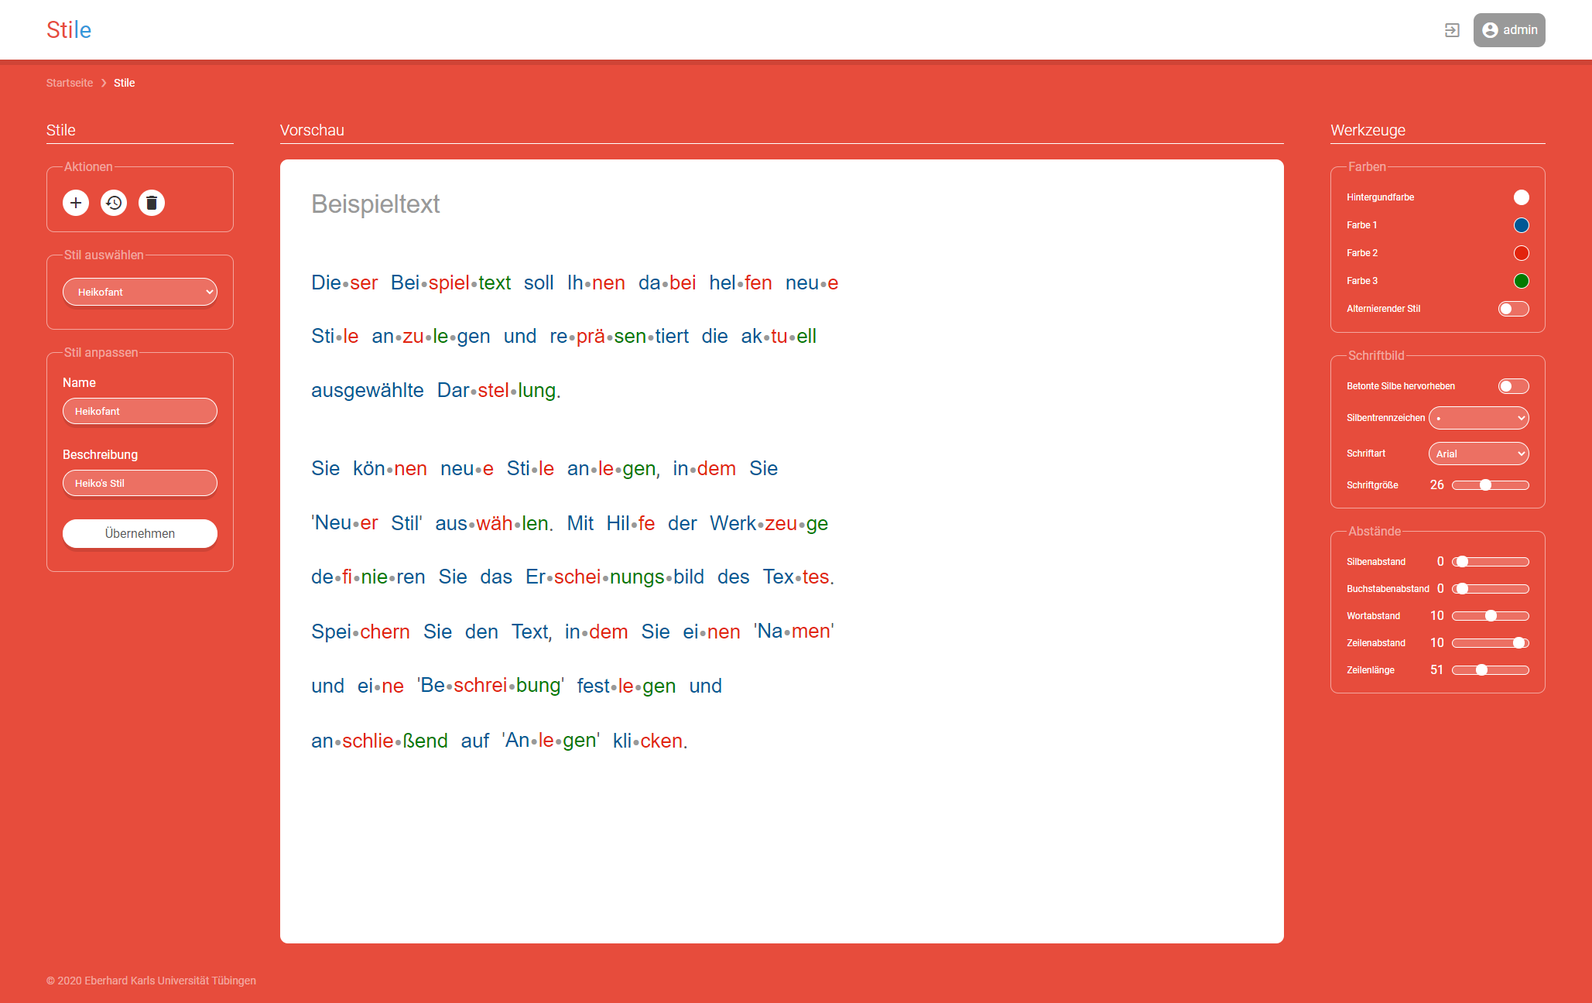
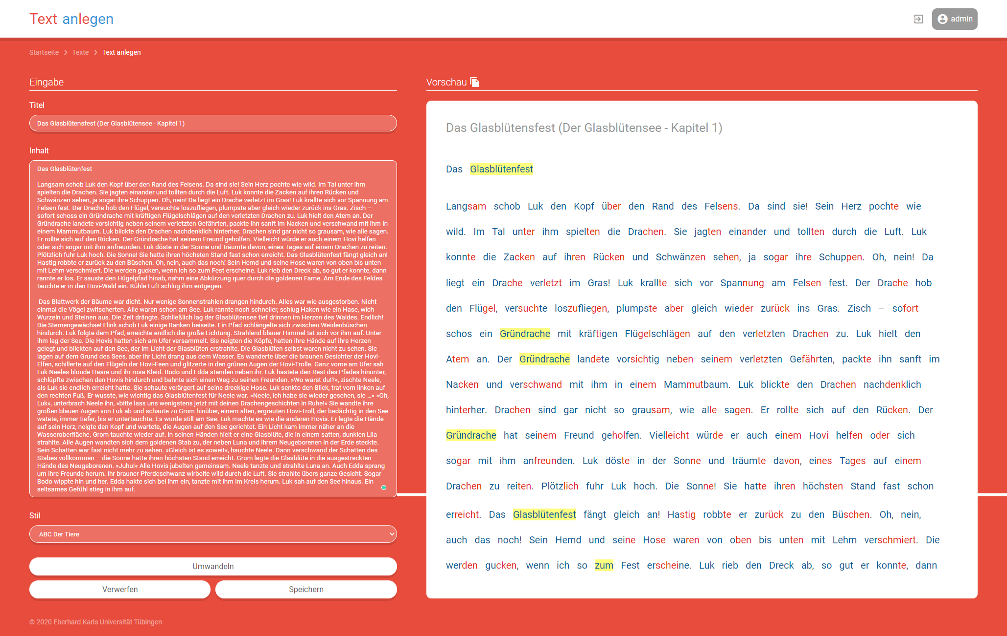
COAST 2.0
Notes:
Ende: 28 Minuten

Slide 25

Future with Gen AI – Limitless Possibilities?
Bild erzeugt mit DALL·E 3

Slide 26

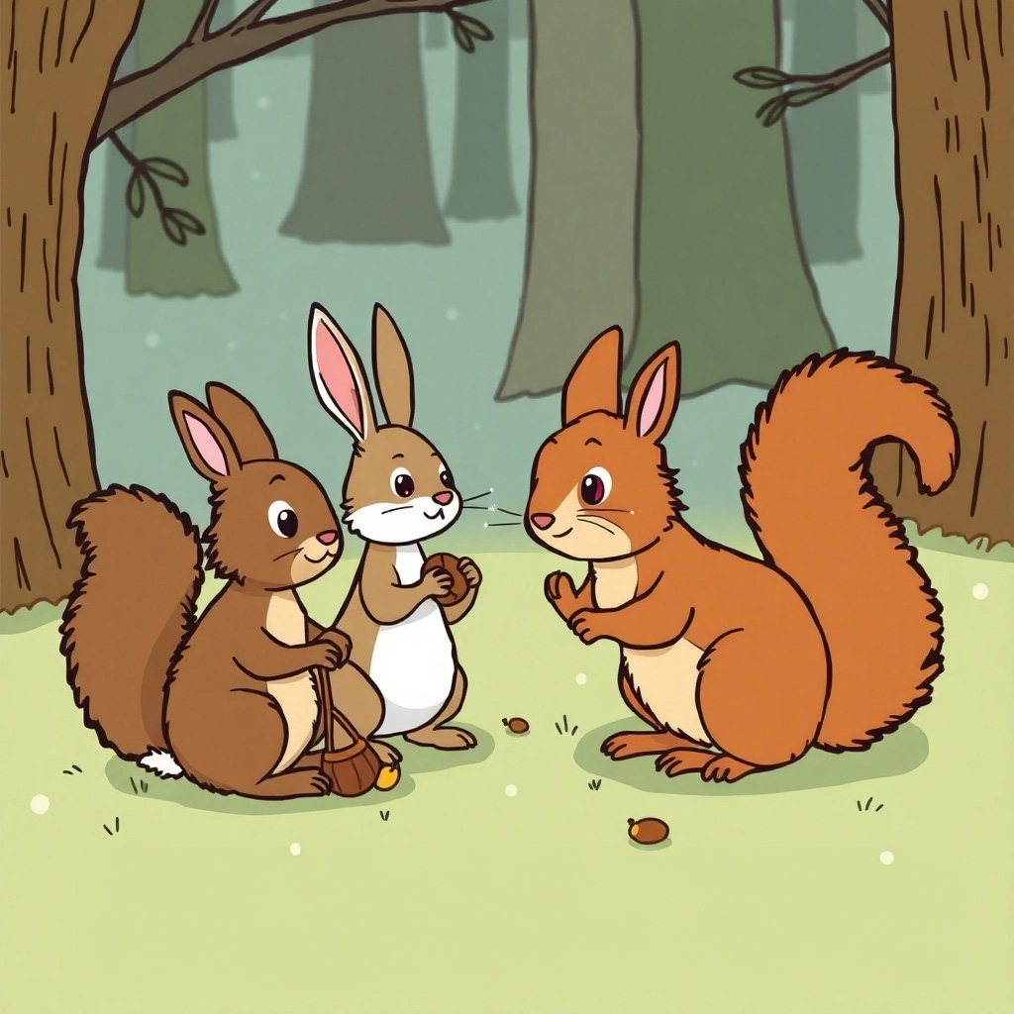



Individually Adapted Reading (Learning) Stories by Combining AI Tools
Image created with flux-ai.io

Slide 27

AI-LIT
AI-supported Literacy Development in Kindergarten for Educational Success, Equity and Social Participation
Notes:
Start: 25 Minuten
As explained in Section 2.2, syllable synthesis and syllable analysis are essential components of evidence-based reading and spelling trainings (Galuschka & Schulte-Körne, 2016). Scheerer-Neumann (1981) has shown that specific training of segmenting words into syllables can improve reading accuracy of reading impaired German primary school children significantly.
Additionally, computer-based programs for primary school children that sequentially speak and highlight syllables can facilitate the learning process of reading (Jiménez et al., 2007; Olson & Wise, 1992).
Based on these empirical findings, visually enhanced texts with custom spacing and syllables alternately displayed in different font colors are commonly used in teaching and learning therapy to support the acquisition of reading and writing.
This socalled “Silbenmethode” (Syllable Method; Mildenberger Verlag, 2018; Röber, 2009) teaches children to focus and understand syllables and their structures rather than single characters and is commonly used in Germany, which is reflected by popular reading materials, such as ABC der Tiere (Animal Alphabet; e.g., Handt, Kuhn, & Mrowka-Nienstedt, 2019, see Figure 6.2) and Leselöwen (Reading Lions; Loewe Verlag, 2020).
COAST ist eine WebApp für die einfache und automatische visuelle Anreicherung / Aufbereitung von Silbenstruktur, Wortbetonung und Abständen in Lesetexten unter Verwendung von NLP

Slide 28

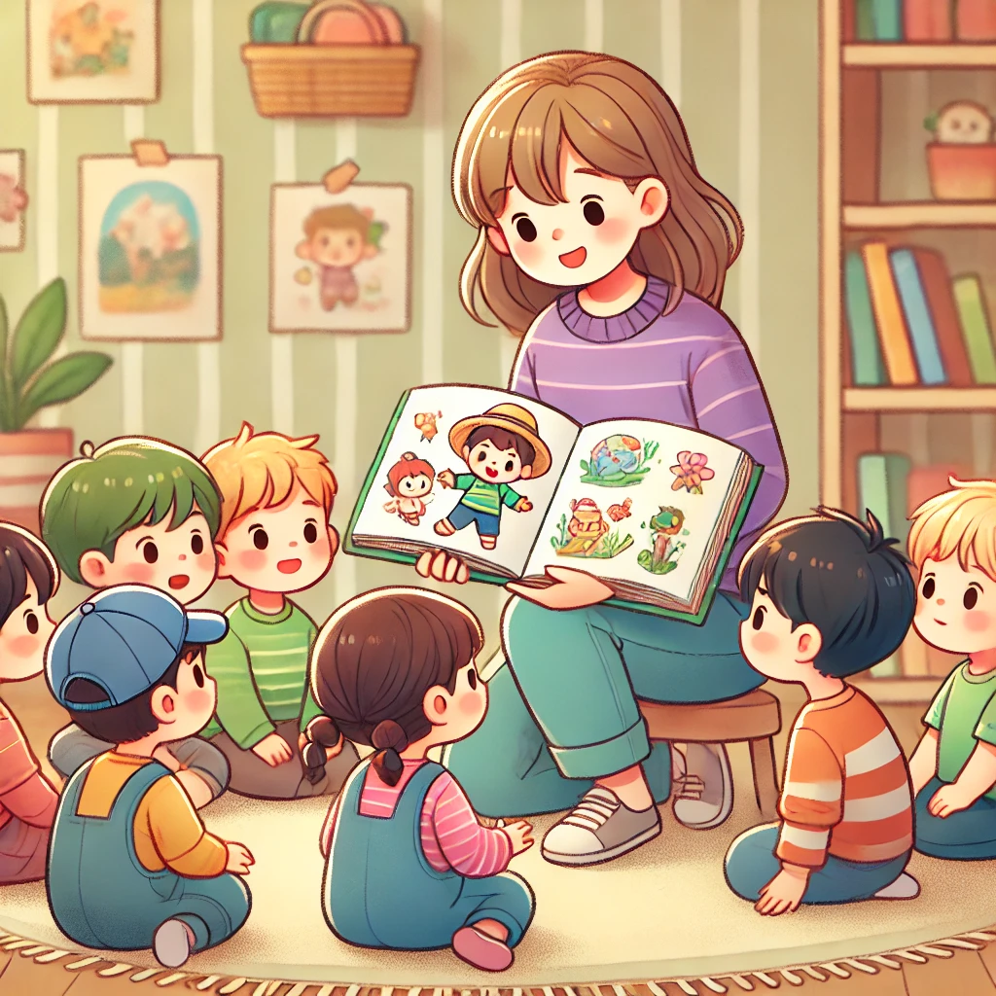


Established Approach: Dialogic Reading
E: Yes, that‘s right! The ball is broken.
R: How did that happen?
…
P: What did the kids do?
…
Ball broke
Dialogic reading requires 1 trained educator per 2-3 children.
This does not scale in practice with the limited personnel that is available.
Notes:
Well, the solution seems obvious: integrating systematic language support in early education
Research already has shown that children with (linguistically) diverse backgrounds in day-care centres and kindergarten can be substantially supported by language interventions
An empirically proven method to support language interventions integrated in everyday life is the Dialogic Reading
It was created to systematically promote language interactions in a picture book reading setting
and is captured by the acronym PEER: prompt, evaluate, expand, repeat.
A Prompt initially stimulates speech production by the child (e.g., “Was haben die Kinder gemacht?”)
Evaluate analyzes the child’s production, which in this example was “Ball putt"
Expand then extends it in a communicatively appropriate way, often with some reformulation, for example, Ja, genau! Der Ball ist kaputt.),
and Repeat continues the dialog (e.g., Wie ist denn das passiert?).
This results in a natural dialogue that effectively promotes receptive and productive vocabulary as well as educational language and narrative skill development – and it has been successfully evaluated with German preschoolers
However, the intervention in practice requires one trained educator per two or three children.
As this doesn‘t scale, it cannot address the fundamental challenge with the limited personnel that is available
-- Alt (pre 2024-11-21)
Well, the solution seems obvious: integrating systematic language support in early education
Research already has shown that language learning for children with (linguistically) diverse backgrounds in day-care centres and kindergarten can be substantially supported by language interventions
An empirically proven method to support language interventions integrated in everyday life is the Dialogic Reading
It was created to systematically promote language interactions in a picture book reading setting
and is captured by the acronym PEER: prompt, evaluate, expand, repeat.
A Prompt initially stimulates speech production by the child (e.g., “Was haben die Kinder gemacht?”)
Evaluate analyzes the child’s production, which in this example was “Ball putt"
Expand then extends it in a communicatively appropriate way, often with some reformulation, for example, Ja! Die Kinder haben den Ball kaputt gemacht.),
and Repeat continues the dialog (e.g., Wie ist denn das passiert?).
This results in a natural dialogue in which the child is given the opportunity to acquire new linguistic structures and expand their vocabulary within the zone of proximal development
Studies and meta-analyses show the effectiveness of dialogic reading on receptive and productive vocabulary as well as on educational language and narrative skill development and it has been successfully evaluated with preschoolers in Germany

Slide 29

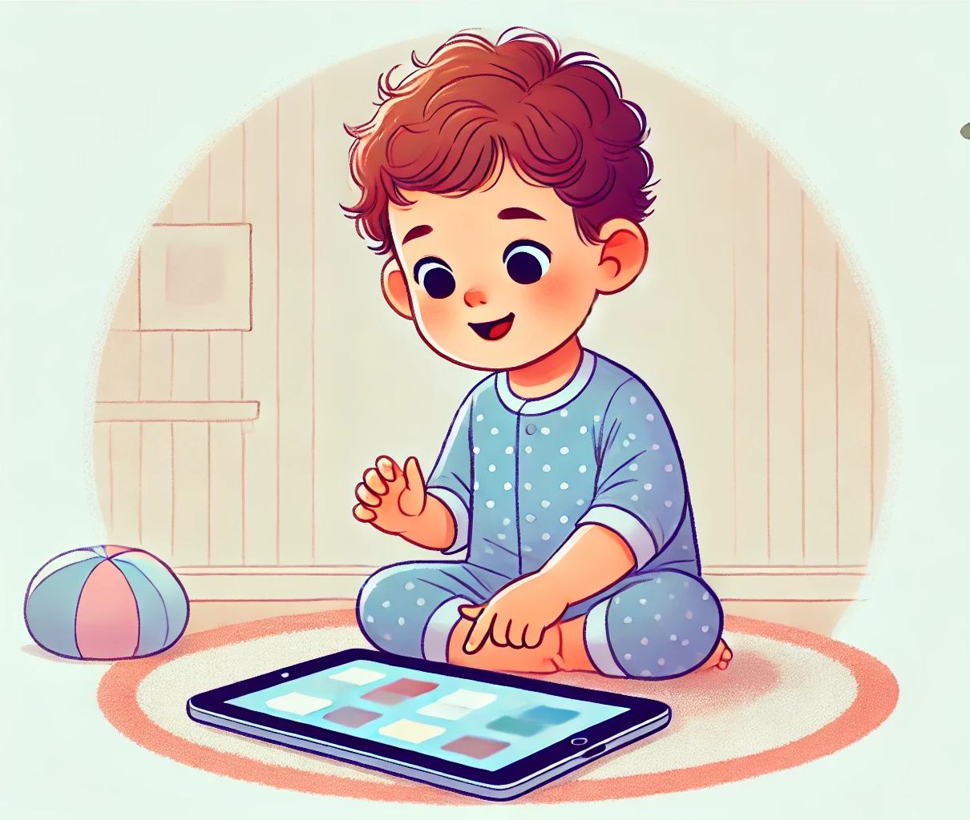

Our Approach: Dialogic Reading 2.0
– With Individual AI-App
Ball putt
…
E: Ja, genau.
Der Ball ist kaputt.
P: Was haben die Kinder gemacht?
…
R: Wie ist denn das passiert?
Notes:
And this is where the AI-LIT project comes in: Dialogic Reading using State-of-the-Art Artificial Intelligence Technology
It realizes dialogic reading as an individualized AI-supported intervention using current Automatic Speech Recognition and Generation as well as Large Language Models
The decisive advantage of our AI-supported implementation is that it scales as needed.
In contrast to the traditional or E-Book dialogic reading, our approach is not limited to small-groups, but can be used in an individualized setting, that is the app can be used by the children independently
As a result, the linguistic interactions are not distributed among several children.
Instead, the individual child can be continuously and adaptively stimulated to produce speech at his or her own level through appropriate prompts and benefit from corrective feedback and the applied modelling techniques.
CLICK
In addition to the advantages of adaptivity and higher interaction frequency, a number of psychological hurdles and insecurities can be avoided:
This is because children with language difficulties often act rather cautiously in social exchange in groups
With AI-LIT, the children can express themselves without shame or even fear of ridicule and can also ask questions if they have not understood something or do not know a word.
CLICK
CLICK
CLICK
This protected setting can help to build more linguistic confidence, which then also encourages the children to participate more linguistically in social contexts.
The AI-supported dialogic reading thus promotes preliteracy skills acquisition in day-care centers and significantly supports both, educators and children
Alt –
And this is where the AI-LIT project comes in: Dialogic Reading using State-of-the-Art Artificial Intelligence Technology
It realizes dialogic reading as an individualized AI-supported intervention using current Automatic Speech Recognition and Generation as well as Large Language Models
The decisive advantage of our AI-supported implementation is that it scales as needed.
In contrast to the traditional or E-Book dialogic reading, our approach is not limited to small-groups, but can be used in a one-to-one setting
As a result, the linguistic interactions are not distributed among several children.
Instead, the individual child can be continuously and adaptively stimulated to produce speech at his or her own level through appropriate prompts and benefit from corrective feedback and the applied modelling techniques.
CLICK
In addition to the advantages of adaptivity and higher interaction frequency, a number of psychological hurdles and insecurities can be avoided that can contribute to children with language difficulties acting rather cautiously in social exchange in groups
In response to the prompts for speech production, the children can express themselves without shame or even fear of ridicule and can also ask questions if they have not understood something or do not know a word.
CLICK
CLICK
CLICK
This protected setting can help to build more linguistic confidence, which then also encourages the children to participate more linguistically in social contexts.
The AI-supported dialogic reading thus facilitates reading acquisitions in day-care centers and significantly supports both, educators and children

Slide 30
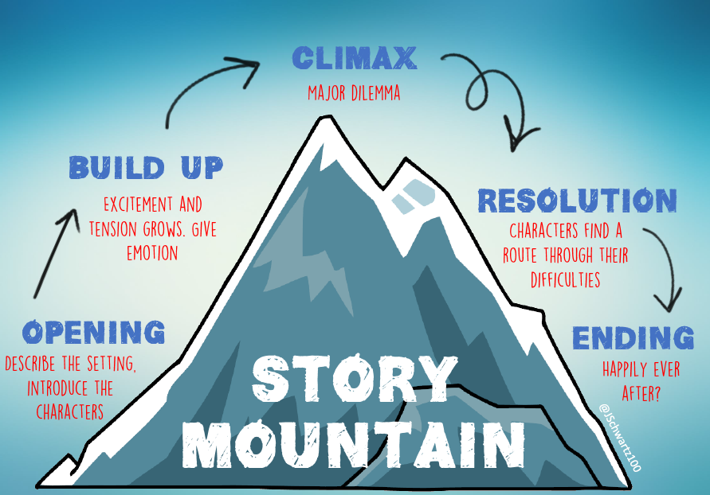



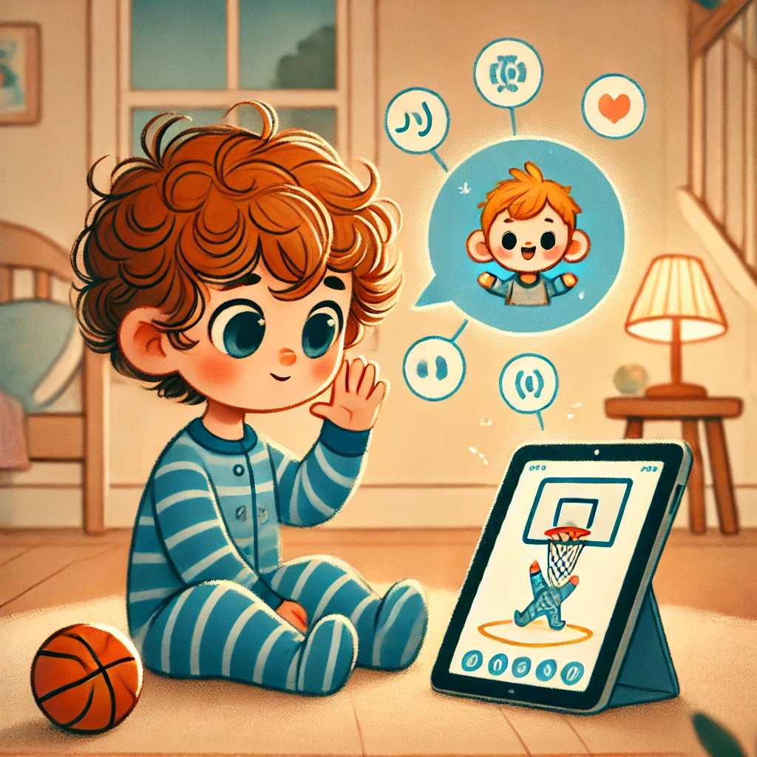
Co-Creation: Professionals and Kids can Create Their Own Stories With Scaffolded AI
co-create the story
automatic picture book creation
actively participate: decide how it continues
Notes:
But we don’t stop here and go one step further:
AI-LIT will support the tailored generation of picture book material in a co-creative process, as it is important to ensure that the support situation is entertaining and geared to the individual interest of the children
Using latest large language models, the language learning material can be generated based on the learners' preferences in terms of content and topics.
Children can co-create their own story and develop and climb their very own story mountain
This allows children to become active participants who can creatively fill the blank pages of the book with their ideas, and the medium itself becomes a tool – as envisaged in the Kompetenzrahmen für digitale Bildung - Competency Framework for Digital Education
Going beyond the choice of topic, AI-LIT will also support children in determining how the story continues, while systematically ensuring that the child is given opportunities to use developmentally proximal language

Slide 31

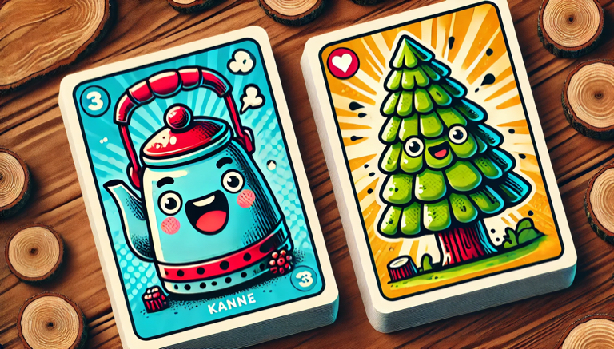
Co-Creation: Professionals and Kids can Create Their Own Stories With Scaffolded AI
co-create the story
automatic picture book creation
actively participate: decide how it continues
input enrichment: educators can align the
story with children's language development
Notes:
With automatic input enrichment, the stories can also be explicitly enriched with appropriate linguistic means that align with the children’s language development
For example, pictures can be automatically generated to contrast word pairs.
This example depicts the practice of initial sounds: Kanne vs. Tanne
The opportunity to shape the stories themselves also promotes co-creativity at all levels, for children and educators alike.

Slide 32



WoLKE www.wolke.schule
WO Bieten KI-Methoden Lösungen für Fachdidaktische Herausforderungen?
Computerlinguistisch fundierte Konzeption und Evaluation curricular Verankertert Lehrveranstaltungen für die Sprach- und Mint-Didaktik
finanziert vom
Notes:
Ziel des Projektes ist es, angehende Lehrkräfte zu einem reflektierten Umgang mit KI-basierten Werkzeugen im Unterricht zu befähigen, die sie hinsichtlich konkreter schulischer Herausforderungen in fachdidaktisch wohlmotivierter Weise unterstützen können.
Ziel des Verbundprojekts „WoLKE – Wo bieten KI-Methoden Lösungen
für fachdidaktische Herausforderungen? Computerlinguistisch fundierte Konzeption und Evaluation curricular verankerter Lehrveranstaltungen für die Sprach- und MINT-Didaktik
ist es, angehende Lehrkräfte zu einem reflektierten Umgang mit KI-basierten Werkzeugen im Unterricht zu befähigen, die sie hinsichtlich konkreter schulischer Herausforderungen in fachdidaktisch wohlmotivierter Weise unterstützen können. Dafür werden für Lehramtsstudiengänge der Sprachen und MINT-Fächer (Mathematik, Informatik, Naturwissenschaft und Technik) fachlich und didaktisch passgenaue Lehr-Lernformate für den reflektierten Einsatz von KI-Tools im Untterricht entwickelt und als neu konzipierte, in das Lehramtsstudium curricular verankerte Lehrveranstaltungen eingeführt. Mit den Lehrveranstaltungen sollen angehenden Lehrkräften systematisch die für einen didaktisch motivierten Einsatz von KI-Tools im Unterricht notwendigen Kenntnisse und Kompetenzen vermittelt werden. Dabei stehen der fachdidaktische Praxisbezug im Sprach- und MINT-Unterricht sowie ein methodisch und ethisch fundiertes Verständnis des Potenzials und der Grenzen der KI-Methoden im Mittelpunkt.
Um dies zu erreichen, werden die Lehrveranstaltungen co-konstruktiv in einem interdisziplinären Verbund aus Computerlinguistik, Informatik, Sprach- und MINT-Didaktik auf Grundlage des internationalen Forschungsstands entwickelt und mit qualitätssichernden Methoden der empirischen Bildungsforschung auf ihre Wirksamkeit überprüft. Zur Entwicklung der Lehrveranstaltungen werden etablierte und aktuelle, textgenerierende KI-Methoden hin-sichtlich Eignung, Reifegrad und Synergiepotenzial für den fachdidaktisch motivierten Einsatz analysiert und nutzbar gemacht.

Slide 33
WoLKE
“WoLKE” (wolke.schule) is an acronym for the core of the issue addressed in the project:
„Wo bieten KI-Methoden Lösungen für fachdidaktische Herausforderungen? Computerlinguistisch fundierte Konzeption und Evaluation curricular verankerter Lehrveranstaltungen für die Sprach- und MINT-Didaktik.“
(engl) "Where do AI methods offer solutions for didactic challenges? Computational linguistics-based design and evaluation of curriculum-based courses for language and STEM didactics."
Notes:
Das Ministerium für Wissenschaft, Forschung und Kunst Baden-Württemberg fördert mit knapp 700.000€ ein gemeinsames Forschungsprojekt der Pädagogischen Hochschulen Ludwigsburg, Schwäbisch Gmünd und der Universität Tübingen zum Einsatz von Künstlicher Intelligenz (KI) im Unterricht.
Im sogenannten „WoLKE“-Projekt werden Lehrveranstaltungen für angehende Lehrkräfte für den didaktisch sinnvollen Einsatz von KI-Methoden und -Werkzeugen im Unterricht entwickelt. In den Lehrveranstaltungen werden angehenden Lehrkräften methodische Kompetenzen vermittelt, wie KI-basierte Werkzeuge unterstützend im Unterricht eingesetzt werden können, um konkreten schulischen Herausforderungen zu begegnen, insbesondere in den Sprachen und MINT-Fächern (Mathematik, Informatik, Naturwissenschaften und Technik). Die angehenden Lehrkräfte sollen dadurch zu einem reflektierten Umgang mit KI-basierten Werkzeugen im Unterricht befähigt werden.
STEM = Science, Technology, Engineering, Mathematics

Slide 34
Goals of WoLKE
Development and evaluation of two courses on AI tools for student
teachers ...
  of language subjects
  of STEM subjects
The aim of the courses is to enable future teachers to reflect on the use of AI tools in the classroom, with regard to…
  specific school challenges (e.g. exams, heterogeneity)
  subject-specific didactic aspects (e.g. subject-specific requirements for AI)
  ethical and social implications (e.g. reproduction of biases)
(Further) development of AI methods and tools with didactic benefits
Notes:
STEM = Science, Technology, Engineering, Mathematics

Slide 35
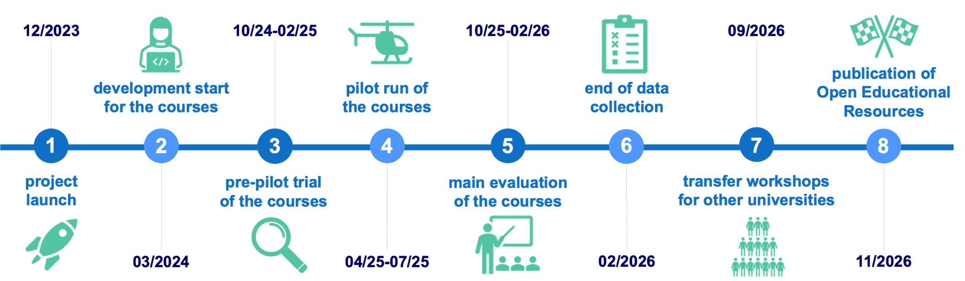







Roadmap
12/2023
10/24-02/25
10/25-02/26
09/2026
publication of Open Educational Resources
development start
for the courses
pilot run of
the courses
end of data collection
1
2
3
4
5
6
7
8
project launch
pre-pilot trial of the courses
main evaluation
of the courses
transfer workshops
for other universities
03/2024
04/25-07/25
02/2026
11/2026

Slide 36
Overview – System and Project Websites
Prosodiya.de: digital spelling training for German primary school children (with and w/o developmental dyslexia)
COAST (https://sfs.uni-tuebingen.de/coast): web-based tool for automatic visual enhancement of reading material
KANSAS-Suche.de: linguistically aware search engine for English and German teachers
WoLKE.schule project: development and evaluation of seminars for student teachers on the didactically motivated and critical reflective use of AI in language and STEM teaching
TuCAN (https://tucantest.org): tablet-based screening tool for neuropsychiatric disorders

Slide 37

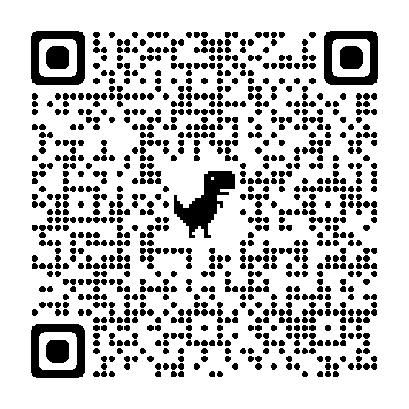
Are You Interested in a Collaboration?
Heiko’s Research Interests
Intelligent Computer-Assisted (Language) Learning → ICA(L)L
Digital Game-Based Learning
Human-/Child-Computer Interaction
Development and Evaluation of Digital Learning Assessment and Screenings
Automatic Input Enhancement
heiko.holz@ph-Ludwigsburg.de

Slide 38

Thank You!
Questions?
Jun.-Prof. Dr. Heiko Holz
heiko.holz@ph-ludwigsburg.de
Pädagogische Hochschule Ludwigsburg
Institut für Informatik
Notes:
https://www.ph-ludwigsburg.de/fakultaet-2/institut-fuer-informatik/personen/heiko-holz

