Slide 1
Ludwigsburg University of Education

Slide 2
Outline
The city of Ludwigsburg
Ludwigsburg University of Education (LUE)
Facts & Figures
Faculties & Institutes
Profil
Courses
Services for Incoming Students at LUE
Overview
Housing
Orientation Programme
Why to choose LUE / My experience
Academic calendar & deadlines
Questions

Slide 3
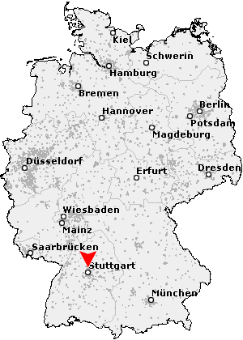
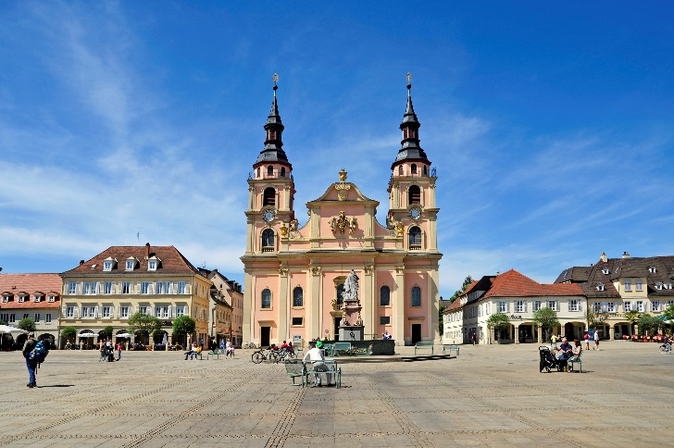
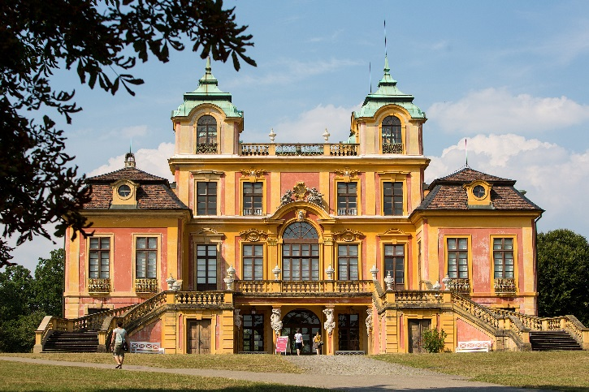
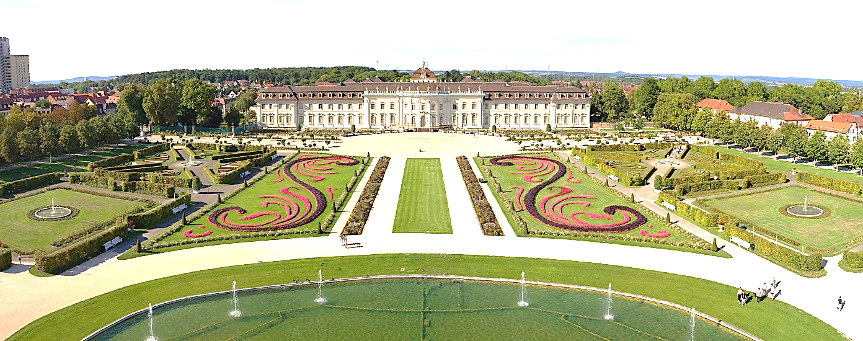
Ludwigsburg
Ludwigsburg with approx. 94,000 inhabitants is situated 20 km north of Stuttgart, the capital of Baden-Württemberg, with about
630,000 inhabitants.
Market Place, © GDA Peter Albig
Favorite Castle, © Tourismus & Events Ludwigsburg
https://youtu.be/Ef9v0QX55D0
Residenz Castle, © Michael Mende
Notes:
Ludwigsburg is a very picturesque baroque town with a magnificent palace and a beautiful market square where the famous Christmas Market takes place. With approx. 95,000 inhabitants, it is small enough to be safe and cosy, yet large enough to offer lively shopping streets, cinemas and a colourful pub scene. Ludwigsburg is also just 15 minutes by public transport from Stuttgart, the capital of Baden-Württemberg and one of Germany's economic hubs. There are also other smaller, very picturesque, medieval half-timbered towns around Ludwigsburg such as Bietigheim-Bissingen, Besigheim or Marbach.

Slide 4
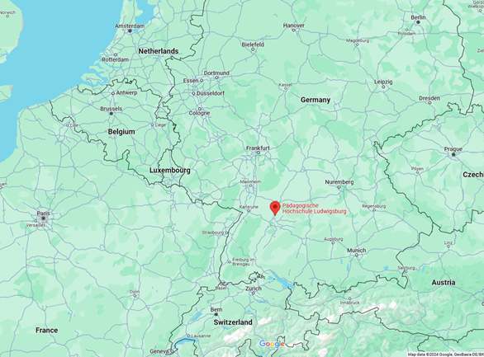
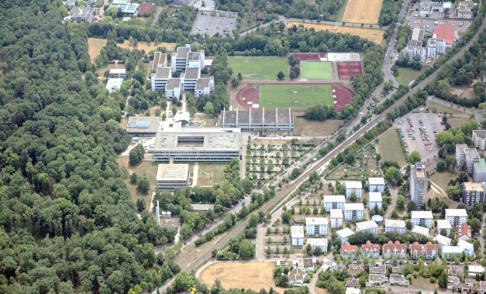
Ludwigsburg
Campus
Train station
Student residence
© Google Maps
Ludwigsburg is in the heart of Europe:
It is only 3 hours by train to Paris, 4 hours to Brussels and 6 hours to Amsterdam. By car you can reach Zurich in 3 hours and Prague in 5 hours.
The university campus and the student residence are located in a very quiet area of Ludwigsburg, next to a park, but still close to the city centre. The student village, campus and train station are all within 5 walking minutes.

Slide 5
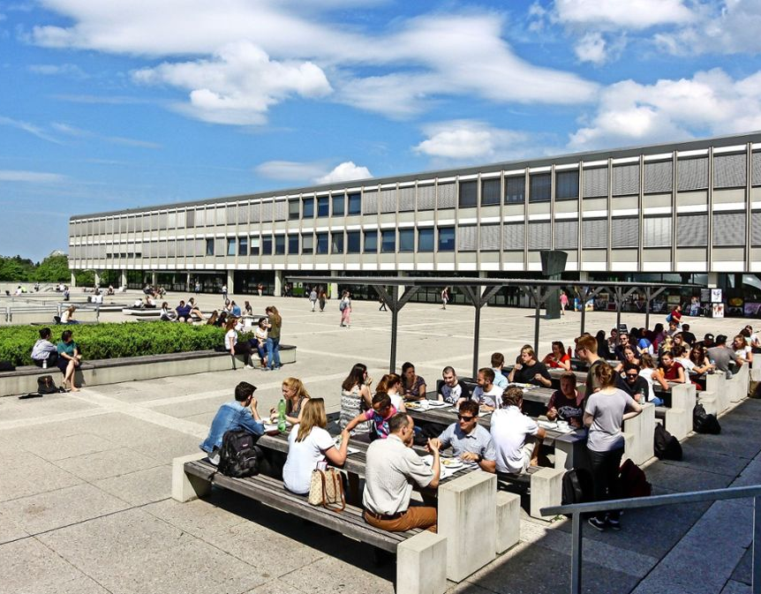
Ludwigsburg University of Education (LUE) Pädagogische Hochschule Ludwigsburg (PHL)
Largest of the six Universities of Education in Baden-Württemberg
approx. 6,000 students
Approx. 480 staff members incl. 320 academic staff members
3 faculties: Educational and Social Sciences, Cultural and Natural Sciences, Special Education
7 Bachelor Programs and 13 Master Programs
https://www.youtube.com/watch?v=VhU1oFIxvLU

Slide 6
University of Education - a special type of university
In 15 of the 16 states in Germany teacher training is offered by universities. Only Baden-Württemberg has Universities of Education (UoE). In Baden-Württemberg, teacher training for upper secondary level is provided by universities and for primary and lower secondary level by Universities of Education.
Advantages:
Clear focus on educational sciences
Focus on pedagogy of teaching
Strengths: theory-based and practice-oriented at the same time
PhD-granting institution

Slide 7
Faculties and Institutes
Faculty I: Educational and Social Sciences | Faculty II: Cultural and Natural Sciences | Faculty III: Special Education
Institute of Educational Management | Institute of Biology | Institute of Special Education (General)
Institute of Educational Science | Institute of Chemistry, Physics and Technology | Institute of Special Education (Areas of Special Needs)
Institute of Economics Education | Institute of German Language and Literature
Institute of Philosophy | Institute of English
Institute of Psychology | Institute of French
Institute of Social Sciences | Institute of Computer Science
Institute of Theology | Institute of Cultural Management
 | Institute of Art, Music and Sport
 | Institute of Mathematics

Slide 8
Profile at a Glance
1) School education
(primary, secondary level, special needs education)
4) Education in cultural and
social areas
(e.g. cultural management)
2) Adult / continuing education
(e.g. educational management, educational research)
3) Children and youth education

Slide 9
Courses
General information:
Exchange students can choose from the entire course catalogue and are not restricted to a specific faculty
Lecturers are flexible with ECTS and grades / certificates of participation
School Practice (Internship) is possible: 2 weeks full-time = 3 ECTS, 2 days per week throughout the entire lecture period (30 days) = 10 ECTS
Course catalogue:
Click here to see the complete course catalogue of previous semesters
Click here to see the list of courses taught in English
Click here to see the International Course package
Criteria to consider when choosing courses:
Students can choose from the entire range of studies (except INEMA MBA Program)
Participation in one German class for Visiting Students is mandatory for international students whose mother tongue is not German (there are 4 levels / 4 hours per week/ 6 ECTS)
Maximum one other language course
LUE suggests to have 20-30 ECTS, expectations of home university and scholarship have to be observed

Slide 10
Services for Incoming Students
Pre-arrival
2 online pre-arrival information sessions
Orientation
Orientation Programme
Intensive support with enrolment, health insurance, residece permit and much more
During semester
Langage tandems
Internship: Teaching Placements
Online schedule consulting, explanatory videos
German language courses, 4 different levels (4 hours/week)
Information meeting to prepare the departure
Monthly „Incoming Come-In“
Excursions to Ludwigsburg Palace, Mercedes Benz Museum in Stuttgart, International Brunch and other activities
Information letters, visa letter (if necessary)
Farewell celebration
Scholarship information (if applicable)
Buddy Programme
Guaranteed accommo-dation
in the student residence nearby

Slide 11
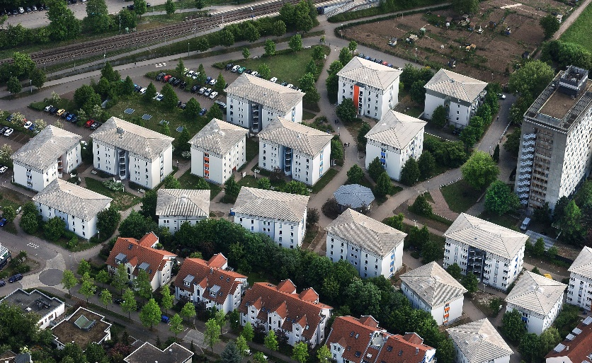
Housing – Student Village Ludwigsburg
Location: 3 minutes’ walk to the university; S-Bahn stop in only 2 min. by foot; supermarket, bank, post office, pharmacy and doctors in max. 5 min. by foot
Single or double room in an apartment (shared apartment) together with other students (women and men)
There’s a large kitchen with a dining area/ living room
Bathroom and toilet are shared with flat mates
Washing machines and dryers are in the basement
All rooms are furnished with bed, closet, table and chair
Common rooms are cleaned by all residents – no cleaning service!
Rent: Single Room € 1.920 / Double room € 1.370 per semester, includes electricity, water and heating (prices valid for winter term 2024/25)
Internet: € 9,50 per month
Bed linen and duvet/pillows can be bought from the janitor (€ 65)
Student Village © Studierendenwerk Stuttgart/ Kuhn
Guaranteed Housing

Slide 12
Orientation Programme
Here is an excerpt from the orientation programme of a previous semester as an example. A similar programme takes place every semester.
What is part of the orientation programme?
Completion of all administrative formalities:
enrollment at the university
health insurance
opening a bank account
registering with the foreigners administration authorities and the town of Ludwigsburg
etc.
Getting to know the other international students and buddies
Explore the university and the surroundings
Excursions, e.g. to the Residential Palace of Ludwigsburg
…
The orientation programme always starts on April 1 / October 1 and runs until the start of the lecture period.
Notes:
Mandatory!

Slide 13
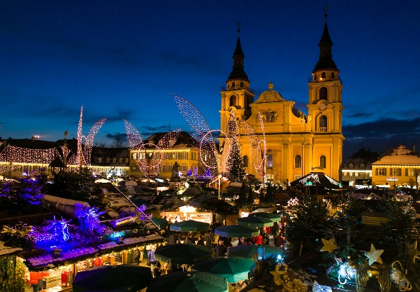
Why to choose LUE for your semester abroad?
University and residence in a very quiet area of Ludwigsburg, next to a park
Lecturers welcome exchange students to their classes and adapt to their needs
Pre-arrival online sessions and intense Orientation Programme (help with all administrative formalities, e.g. Enrollment, Registration city, Residence Permit)
In the heart of Europe: Only 3 hours by train to Paris, 4 hours to Brussels, 6 hours to Amsterdam; by car you are in Zurich in 3 hours and in Prague in 5 hours
Buddy-Programme (1:1, very engaged community)
Workshop in Academic Writing, Language Support Centre, Language Tandems etc.
International Course Package with courses that are taught in English and offered regularly
(Free) German language courses with 4 different levels (4 hours / week, 6 ECTS)
Possibility to gain practical experience: Internship at Schools (2 weeks full-time 3 ECTS, 2 days per week throughout the entire lecture period 10 ETCS)
Guaranteed room at the student residence next to the university for all exchange students
Students can choose from the entire course catalogue and are not restricted to a specific faculty
Only 15 minutes by train from Ludwigsburg to Stuttgart, the capital of Baden-Württemberg
Ludwigsburg is a very picturesque Baroque town with a magnificent palace and a beautiful market square hosting the famous Christmas Market
LOCATION
Christmas Market, © T&E, Stollenberg
COURSES
© Google Maps
SUPPORT
University, student residence and train station are all within 5 walking minutes

Slide 14
Why to choose LUE for your semester abroad?
What our incoming exchange students think:
What students like:
Quick integration, easy to meet other students because of buddy programme, language tandems, sport activities, interactive courses, shared flats at student residence
Goood support / easy organisation of the stay
Good location to explore Germany / Europe
Good course offering in different disciplines

Slide 15
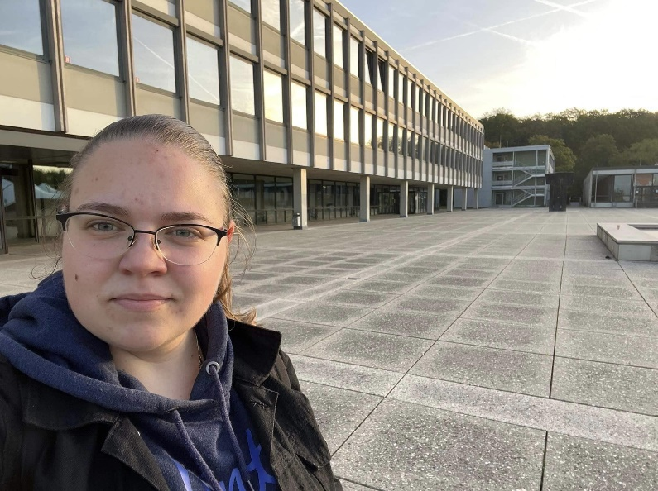
Why to choose LUE for your semester abroad?
What our incoming exchange students say:
Of course you can describe your own experience here
One of the notable differences between my home university and Ludwigsburg University of Education was the course selection, during which we were able to select courses at the Department of German Language and Literature as well as courses at other faculties…. I took the opportunity to select not only the required courses, but also courses that interested me personally. During the whole stay I was amazed and surprised by the helpfulness and friendliness of the lecturers at LUE. Creativity reaches its peak, namely in terms of innovative and imaginative teaching approaches and homework. Students have the opportunity to work on tasks such as podcast production, Wikipedia creation, theatre criticism, and film and performance analysis.
Kristina Perić, University of Kragujevac, Serbia (freely translated from German)
You can find more testimonials on https://www.ph-ludwigsburg.de/en/international/international-exchange-students/why-lue

Slide 16
Academic Calendar and Nomination/Application Deadlines
 | Semester dates | Nomination deadlines | Application deadlines
Winter term | October 1st – March 31st | May 1st | May 15th
Summer term | April 1st – September 30th | December 1st | December 15th
Summer term 2025
Lecture period: April 7, 2025 – July 25, 2025
Examination weeks: July 28, 2025 – August 8, 2025
Winter term 2025/26
Lecture period: October 13, 2025 – January 30, 2026
Examination weeks: February 2, 2026 – February 13, 2026

Slide 17
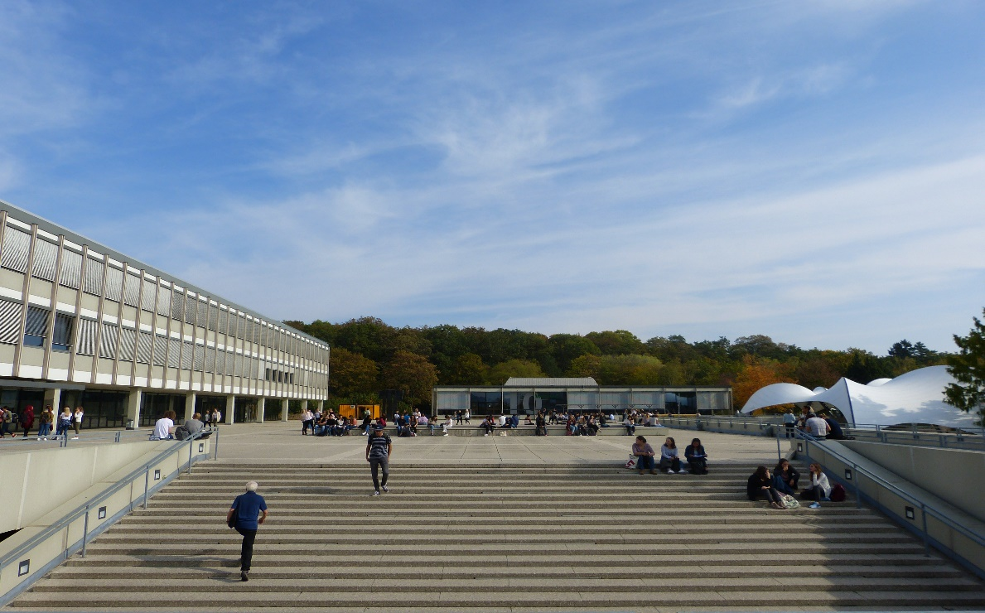
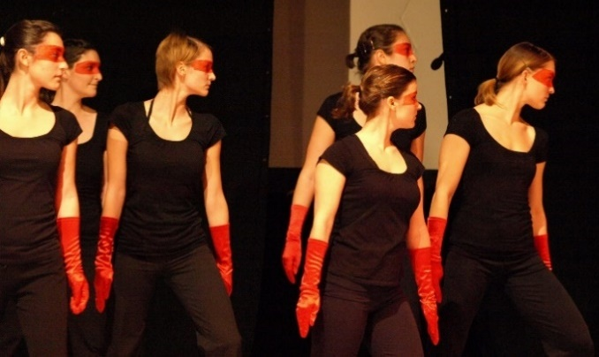
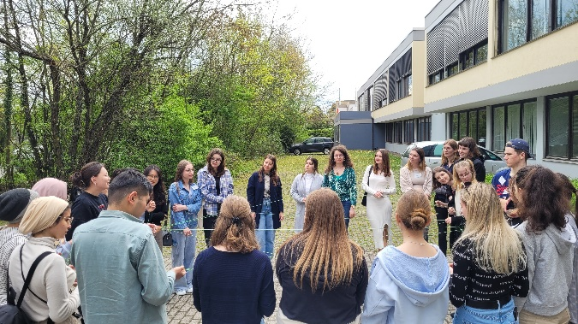
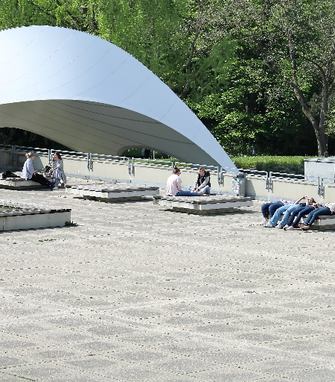
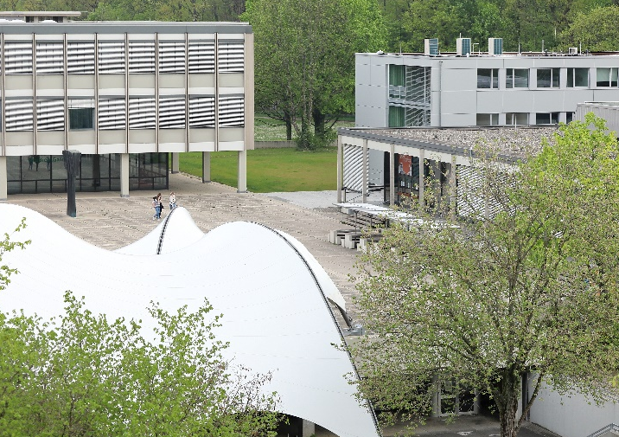
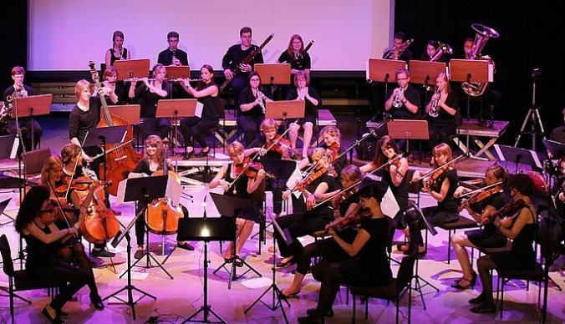
Impressions

Slide 18
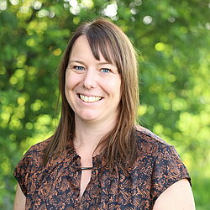
Do you have any questions?
You can always ask me
or contact the LUE Incoming Team directly
Add your name
Email: and Email address here
LUE Incoming Student Mobility Team
Email: incomings@ph-ludwigsburg.de
Denise Wintrich,
Coordinator Incoming
Students at LUE
More information:
https://www.ph-ludwigsburg.de/en/international/international-exchange-students

Slide 19
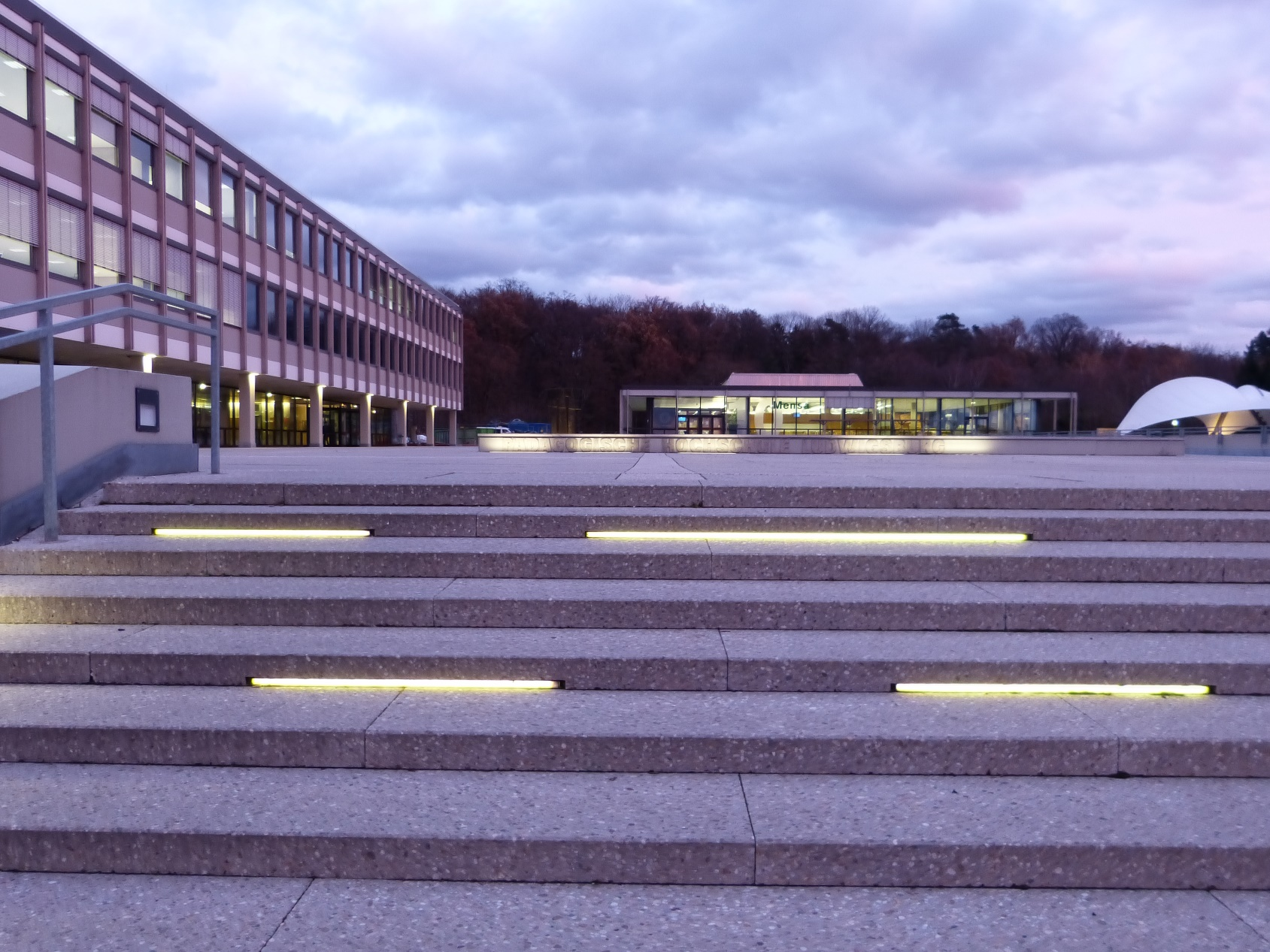
Thank you for your Attention!

